Slide 1
Active Learning 101
Why and How to Get Started
Michael S. Kirkpatrick
CFI New Faculty Orientation
August 20, 2018

Slide 2
“Learning is…”

Slide 3
Learning is…
Abilities
Knowledge
Retrieval
Application
CHANGE
Attitudes
AREA OF INQUIRY
Factual knowledge
Feedback
METACOGNITION
Context
Progress
Practice

Slide 4
A short quiz
True or False:
Good learning makes us feel confident and clear.
Learning can occur without intentional effort.
You have to be interested and motivated to learn.
Intelligent people learn more easily.
Adapting instruction based on learning styles has no effect on learning.
Rereading textbooks efficiently reinforces concepts and leads to greater mastery.
✕
✓
✕
✕
✓
✕
M. Pasupathi, How We Learn. The Great Courses. Chantilly, VA, USA: The Teaching Company, 2012.
P. Brown, H. Roediger, and M. McDaniel, Make It Stick : The Science of Successful Learning.
Cambridge, MA, USA: Harvard University Press, 2014.

Slide 5
ALL
“Adopting instructional practices that engage students in the learning process is the defining feature of active learning.”
–Michael Prince

Slide 6
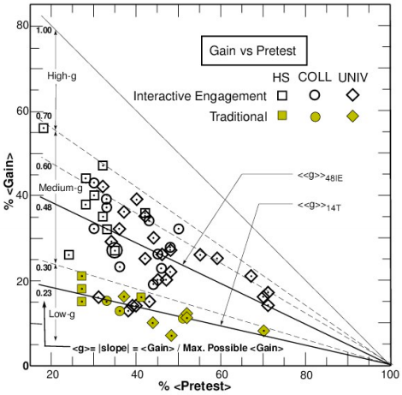
Why active learning?
Pre- vs. post- in physics
Mechanics Diagnostic
Force Concept Inventory
Multiple institutions
62 courses (14 trad.)
6542 students (2084)
Body Level One
Body Level Two
Body Level Three
Body Level Four
Body Level Five
R.R. Hake, "Interactive-engagement vs traditional methods: A six-thousand-student survey of
mechanics test data for introductory physics courses," Am. J. Phys. 66, 64- 74 (1998).
http://www.physics.indiana.edu/~sdi/ajpv3i.pdf

Slide 7
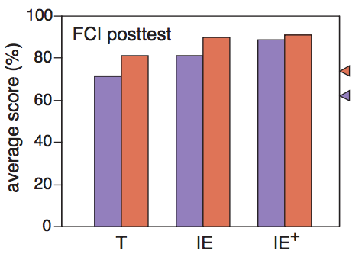
Why active learning?
Closing the gender gap
Pre-test scores different
Gap persisted with lecture
IE+ post-test equal
Requires more than just interactive lecture
T: traditional lectures
IE: interactive lectures
IE+: interactive assignments, lectures, tutorials
E. Mazur, “The scientific approach to teaching: Research as a basis for course design,” keynote/plenary
talk at the International Computing Education Research Conference (ICER), 2011.
http://mazur.harvard.edu/search-talks.php?function=display&rowid=1712

Slide 8
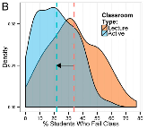
Why active learning?
Metaanalysis
158 studies (exams/CIs)
0.47 SDs on scores
6% course grade
67 studies (failure rate)
33.8% ⇒ 21.8%
S. Freeman et al., “Active learning increases student performance in science, engineering, and mathematics,” Proceedings of the National Academy of Sciences 111(23), 8410- 8415, 2014.
http://www.ncbi.nlm.nih.gov/pmc/articles/PMC4060654/pdf/pnas.201319030.pdf

Slide 9
Why active learning?

Slide 10
But, um, aren’t you…

Slide 11
Human cognitive architecture
Long-term memory
Amassing
Information store

Slide 12
Human cognitive architecture
Long-term memory
Amassing
Acquiring
Information store
Borrowing/ reorganizing
Randomness
as genesis

Slide 13
Human cognitive architecture
Central executive
Working memory
Amassing
Acquiring
Auditory loop
Information store
Borrowing/ reorganizing
Visual-spatial sketchpad
Randomness
as genesis
Interaction
Narrow limits
of change
WM Capacity:
4-7 items (2-3 novel)
20 seconds maximum
Environmental linking

Slide 14
Far transfer
90 ft
90 ft
x
90 ft
90 ft
90 ft
90 ft
Apply the Pythagorean
theorem to the above
triangle to find the value
of x.
In a baseball diamond, the distance between each base is 90 ft. Which of the following is true about the shortest distance between 1st and 3rd bases (the red line shown above)?
It is less than 90 ft.
It is between 90 and 120 ft.
It is greater than 120 ft.

Slide 15
Which of these principles of human cognition best explains why active learning is more effective than traditional lecture?
Information store
Borrowing and reorganizing
Randomness as genesis
Environmental linking

Slide 16
Two systems of thinking
System 1 - Automatic
Quick
Effortless
Involuntary
Associative
System 2 - Effortful
Lazy controller
Calculations
Critical thinking

Slide 17
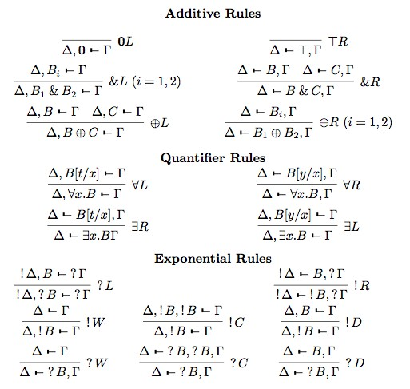
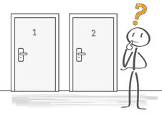
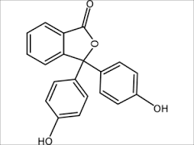
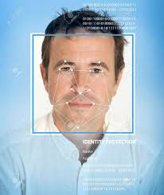
Types of knowledge
Biologically Primary
Biologically Secondary

Slide 18
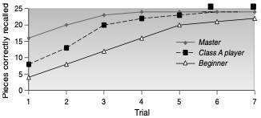
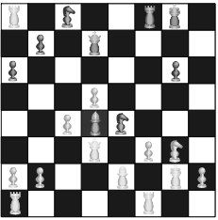
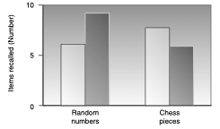
Retrieval fluency
J.D. Bransford et al., How People Learn: Brain, Mind, Experience, and School. National Academy Press. 2000.
https://www.nap.edu/catalog/9853/how-people-learn-brain-mind-experience-and-school-expanded-edition

Slide 19
Cognitive Load Theory
Extraneous
Load
Germane
Load
Goal-free
effect
High
Intrinsic Load
Modality
effect
Worked example effect
Low
Intrinsic Load
Variability
effect
A
Redundancy effect
F
Expertise reversal effect
B
E
C
D

Slide 20
Worked example effect
Step 1: Identify the shapes
There are two right triangles with sides that are 90 ft and the red line as hypotenuse.
Step 2: Recall the formula
Pythagorean theorem:
a² + b² = c²
Step 3: Substitute known values
90² + 90² = c²
Step 4: Solve for c
8100 + 8100 = c²
16,200 = c²
sqrt(16,200) = sqrt(c²)
90 sqrt(2) = c
Step 5: Make a selection
Since 1 < sqrt(2) < 2, 90 < c < 180, so the correct answer is (2) between 90 and 180 ft.
90 ft
90 ft
90 ft
90 ft
In a baseball diamond, the distance between each base is 90 ft. Which of the following is true about the shortest distance between 1st and 3rd bases (the red line shown above)?
It is less than 90 ft.
It is between 90 and 120 ft.
It is greater than 120 ft.

Slide 21
Variability effect
Calculate distance between (1,1) and (4,5)
Step 1: Identify the facts
Distance is the length of a hypotenuse, for a triangle with sides as the change in x and the change in y.
Step 2: Recall the formula
Pythagorean theorem:
a² + b² = c²
Step 3: Substitute known values
(4-1)² + (5-1)² = c²
Step 4: Solve for c
3² + 4² = c²
9 + 16 = c²
25 = c²
5 = c
Low variability:
Find distance between (2,3) and (8,11).
Medium variability:
Find distance between (2,1) and (x,13).
High variability:
Find (x,y) that has distance of 5 from (3,4).

Slide 22
Redundancy effect
The redundancy effect occurs when information is presented in a way that includes redundant material. One example of this is to present the same idea using both visual and executive modalities, such as reading from a PowerPoint slide that has a lot of text on it. The text itself is processed initially as visual imagery, then as auditory as we “read aloud” to ourselves internally. This induces extraneous cognitive load as our minds have to cross-reference the three forms to make sure they are the same. The effect is made worse when the instructor’s voice is also reading the words. Those words must also be cross-checked for accuracy. In the end, the information is lost before it can be transferred to LTM.

Slide 23
Notice anything?

Slide 24
Redundancy effect
The redundancy effect occurs when information is presented in a way that includes redundant material. One example of this is to present the same idea using both visual and executive modalities, such as reading from a PowerPoint slide that has a lot of text on it. The text itself is processed initially as visual imagery, then as auditory as we “read aloud” to ourselves internally. This induces extraneous cognitive load as our minds have to cross-reference the three forms to make sure they are the same. The effect is made worse when the instructor’s voice is also reading the words. Those words must also be cross-checked for accuracy. In the end, the information is lost before it can be transferred to LTM.
Don’t
abandon
UDL

Slide 25
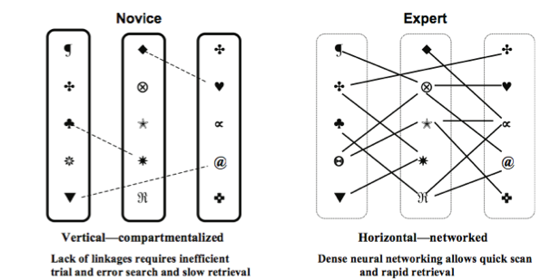
Expertise reversal effect

Slide 26
GOOD
BAD
R
I
S
E
etrieval practice
assive observation
P
R
I
Ma
L
nterleaving
ereading texts
pacing
ntuitive judgments
laboration
ssed practice
Deliberative effort
Pre-learning
Growth mindset
Metacognition
earning styles

Slide 27
Assessment jigsaw
When is it good to use?
What is the effort and impact?
How does it RISE?

Slide 28
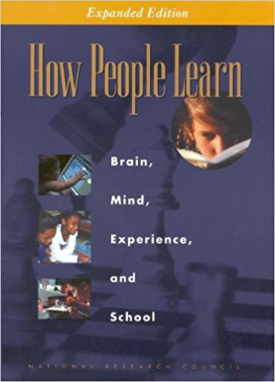
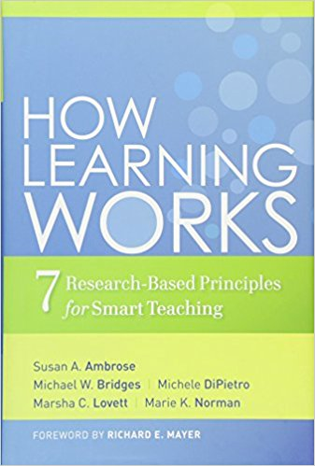
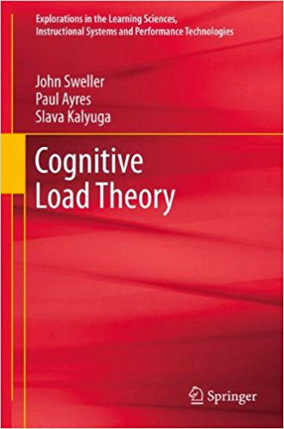
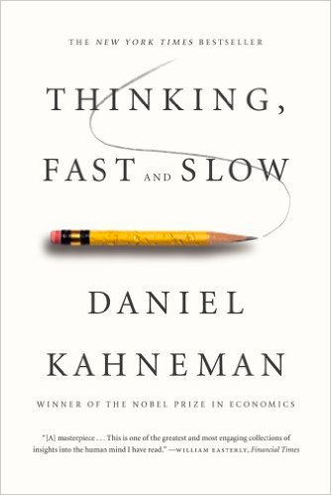
Recommended reading

