Slide 1
Student Perspectives of TBL in a CS Course: Summary of Qualitative Findings
Michael S. Kirkpatrick
SIGCSE Technical Symposium
March 2017

Slide 2
TBL implementation
Team-based Learning (TBL)
Flipped pedagogy developed by Larry Michaelsen
Course divided into 5-7 modules
Founded on constructivism and group process dynamics
Preparation (Pre-Class) | Readiness Assurance Diagnostic - Feedback | Application of Course Concepts
 | 45-75 minutes class time | 1-4 hours class time
1
2
3
4
5
6
Individual
Study
Instructor Feedback
Application
Oriented
Activities
Written Appeals
Team Test
Individual Test

Slide 3
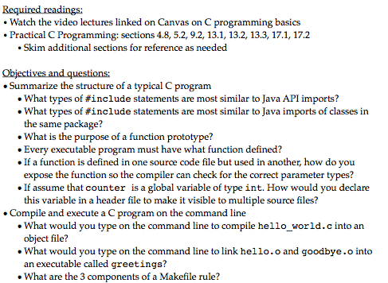
Pre-module preparation

Slide 4
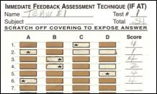
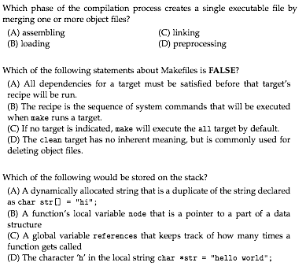
Readiness Assurance Process (RAP)

Slide 5
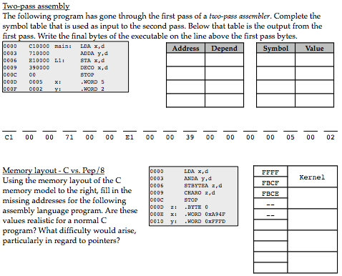
Application activities

Slide 6
Major assessments
Module 1 | Module 2 | Module 3 | Module 4 | Module 5 | Module 6
 | Team Exam | Individual Exam |  | Team Exam | Final Exam
Project 1
Project 2
Project 3
Project 4

Slide 7
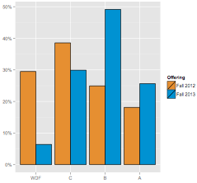
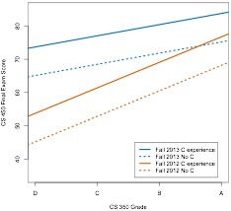
Prior results (ITiCSE 2015)
Kirkpatrick, M.S. and Prins, S. “Using the Readiness Assurance Process and Metacognition in an Operating Systems Course.” 20th Annual Conference on Innovation and Technology in Computer Science Education (ITiCSE), July 2015,
http://dx.doi.org/10.1145/2729094.2742594.

Slide 8
Do students perceive value in using TBL in CS classes?
Does this perception change?

Slide 9
Setting
Master’s university, very high undergraduate
More selective, full-time, lower transfer-in
CS department is primarily undergraduate
300-level Computer Organization
30 sophomores, 47 juniors, 34 seniors (111 total)
28+27 using TBL (one instructor)
27+29 using traditional lecture (different instructor)

Slide 10
Mixed-methods design
Quantitative
Value of Teams Survey (VTS)
Working with Peers
Value of Group Work
Qualitative
Semi-structured focus groups in 12th week
8+6 participants (each team represented)
Anonymized transcripts
Open & axial coding
No inter-rater reliability

Slide 11
Transcript coding results

Slide 12
Value of in-class collaboration
Greater learning, but difficult | Correct answers emerged from discussion | Mixed feelings on making projects collaborative
“[I]t’s easier to ask your peers that are in your immediate group if you don’t understand something.” | "Even if everyone didn’t know the answer exactly, like when we talk about it we somehow come up with an answer.” | “I mean as programmers we’re gonna be working on teams and developing software programs.”
“I would say it was harder to do things out of class, but in class was a lot more valuable time.” | “I made a joke along the lines of as a group we work really well together, but as an individual entity we all suck.” | “I think there are others that might use that as a way to cruise.”

Slide 13
Team formation is problematic
Split opinions on balanced vs. unbalanced teams | Survey-based team assignment can be manipulated, but no better choice
“I think maybe if that was improved then the teams could be more balanced... I feel like there could be better ways to balance the groups and that would really enhance the experience.” | “[I]t all depends how honest you are on the survey too. Cuz if you say that, ‘Okay, I’m not proficient in this,’ and then you actually are, and then you’re put in the group with a bunch of a people who are really good at it.”
If “he puts you in the group [with] people who don’t know, I feel like then you guys will work harder… You guys will teach each other, like, ‘Hey, guys, we don’t have anyone that really knows the stuff in the group, so we’re gonna work hard to get it.’” | “That’s not to say that I’d like to choose the groups on my own because I feel like that could be unfair to the people who don’t know anybody.”

Slide 14
Factors that influence success
Preferred effort and formative evaluation over ability | Team dynamics create risks | Team structure mostly encourages accountability
“I’d rather have you try and get the answer wrong than just to sit there and not do anything at all.” | “[I]f you have [mixed ability groups], they’re supposed to try and teach them, but they’re introverted or don’t care, they’re not gonna teach anything to us.” | “If you feel that they’re gonna rely on you, then you might be more inclined to make sure that you read and make sure you know.”
“[A:] “I feel like [peer evaluations] should be maybe twice during the semester.” [B:] “I know. Cuz at the end of the semester what good is it gonna do [chuckles]?” | “They would go into that stuff so fast, and I was literally so lost. I had so much anxiety the first couple of weeks because I didn’t know what was going on. They didn’t wanna take the time to explain it to me.” | “[I]t’s kind of a self-correcting system. I mean eventually they might kind of reap the rewards for a while, but you’re gonna face what’s happening in the class.”

Slide 15
RAP frustrations
Reading assignments are insufficient preparation | RAP reveals misunderstandings | Sometimes RAP is insufficient feedback
“He gives you a reading, but it’s not...this is not like a history class where you just read it and get all the materials there. It’s kinda hard.” | “I feel a certain point of this is to show you how wrong you are in thinking whatever you thought you knew from studying…” | “They’re not gonna–not everyone’s gonna explain every single answer that they put, and then they’re like, ‘Okay, we got that right,’ but you still have no idea why that was the right answer.”
“We basically had to teach ourselves and then we got graded on that. Then we wouldn’t learn...until we did the activity, which was after the quiz, so not very effective.” | “[T]he iRAT would show me what I think I know versus what I don’t know, which is usually 70 percent or whatever. Then the tRAT sort of allows us to collectively come together and reason out why.”

Slide 16
Team exams
New process skills and new test-writing approach required
“[I]f we start a problem and then I say what I think the answer is and then my group, they disagree, then we have to talk about it.”
“If we split up the team exam into different sections so certain people do certain parts, that defeats the point of it.”
“[W]e had that idea in the back of our mind, like we practiced that the day before and we had a strategy. That was something we vocally talked about the day before our second exam cuz we didn’t do quite as well on our first exam. Talking about pacing ourselves.”

Slide 17
Recommendations
Be transparent about the process of assigning students to teams. Use objective metrics to the extent possible.
Provide explicit instruction for TBL process skills, including how to prepare for team exams and the iRAT.
Supplement reading assignments with scaffolding materials to facilitate achieving desired learning objectives for the RAP.
Consider replacing or augmenting the iRAT with a pre-class online quiz.
Ask for additional points of confusion after addressing commonly missed tRAT questions.
Make team exams shorter than individual exams to allow for discussion and to be mindful of the impact of absences.
Provide time estimates for team exam problems.

Slide 18
Thank you
kirkpams@jmu.edu

