Slide 1
Evaluating an Alternative CS1 for Students with Prior Programming Experience
Michael S. Kirkpatrick
Chris Mayfield
SIGCSE Technical Symposium
March 2017
Evaluating an Alternative CS1 for Students with Prior Programming Experience
SIGCSE 2017 • Kirkpatrick and Mayfield

Slide 2
JMU Introductory Sequence
Java
Not Java
CS1
CS2
CS 139
(4 cr.)
CS 239
(4 cr.)
CS 240
(3 cr.)
Java
Development process
Control structures
Variables and expressions
Functions
Arrays
Classes/objects
Console I/O
Classes/objects
OOP concepts
Packages
References
Recursion
Exceptions
Basic file I/O
Design and testing
Collections
New language
Recursion
Asymptotics
Searching
Sorting
Hashing
Trees
MA 205
(3 cr.)
Applied Calculus
Evaluating an Alternative CS1 for Students with Prior Programming Experience
SIGCSE 2017 • Kirkpatrick and Mayfield

Slide 3
JMU Introductory Sequence
CS 139
(4 cr.)
CS 239
(4 cr.)
CS 240
(3 cr.)
CS1
CS2
CS1
CS2
Goals and benefits
No prior exposure required
Emphasis on algorithmic thinking
Maintain positive climate
Small class sizes
Exposure to two languages
CS 139
(4 cr.)
CS 239
(4 cr.)
CS 240
(3 cr.)
MA 205
(3 cr.)
MA 205
(3 cr.)
Evaluating an Alternative CS1 for Students with Prior Programming Experience
SIGCSE 2017 • Kirkpatrick and Mayfield

Slide 4
JMU Introductory Sequence
C students just left later...
Fall 2014: Prereq + Calculus
Fall 2013: Accelerated Java
CS1
CS2
CS1
Prereq: C
Prereq: B-
CS 139
(4 cr.)
CS 239
(4 cr.)
CS 159
(3 cr.)
CS 240
(3 cr.)
Students with prior exposure
CS 149
(3 cr.)
Not enough for Big-O analysis
MA 205
(3 cr.)
MA 235
(3 cr.)
Evaluating an Alternative CS1 for Students with Prior Programming Experience
SIGCSE 2017 • Kirkpatrick and Mayfield

Slide 5
Key (Research) Questions
Effects on retention
Did either change affect retention into CS 159?
Did either change affect retention beyond CS 159?
Effects on successful progression
How did they do in CS 240?
Effects on underrepresented groups
Do overall effects extend to women and underrepresented minority students?
Evaluating an Alternative CS1 for Students with Prior Programming Experience
SIGCSE 2017 • Kirkpatrick and Mayfield

Slide 6
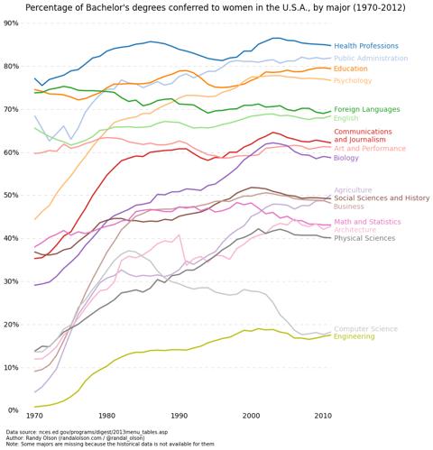
Evaluating an Alternative CS1 for Students with Prior Programming Experience
SIGCSE 2017 • Kirkpatrick and Mayfield

Slide 7
Research Hypotheses
CS 159 and CS 240 retention
The split sections improve retention.
The Calculus/B- change led to drop in retention.
CS 159 and CS 240 grades
CS 139/149 has no effect on CS 159 or CS 240 grades.
Skip CS 139/149 with AP 4 yields difference in CS 159.
AP 4 + CS 139/149 no difference in CS 159 or CS 240 relative to AP 5.
Effect on women and URM students
Split sections improve women/URM retention.
Calculus/B- had disproportionate effect on women/URM.
Evaluating an Alternative CS1 for Students with Prior Programming Experience
SIGCSE 2017 • Kirkpatrick and Mayfield

Slide 8
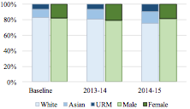
CS 139/149 Demographics
Evaluating an Alternative CS1 for Students with Prior Programming Experience
SIGCSE 2017 • Kirkpatrick and Mayfield

Slide 9
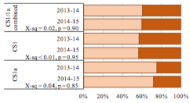
CS 139/149 → CS 159/239 Retention
No overall effect after splitting sections
Difference between CS 139 and previous combined
No effect after adding B- prerequisite
Evaluating an Alternative CS1 for Students with Prior Programming Experience
SIGCSE 2017 • Kirkpatrick and Mayfield

Slide 10
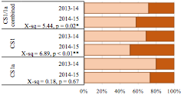
CS 159 → 240 Retention
No effect after accelerated split
Significant difference after Calculus/B-, but...
Evaluating an Alternative CS1 for Students with Prior Programming Experience
SIGCSE 2017 • Kirkpatrick and Mayfield

Slide 11
Research Hypotheses
CS 159 and CS 240 retention
The split sections improve retention.
The Calculus/B- change led to drop in retention.
✕
✓ / ✕
CS 159 and CS 240 grades
CS 139/149 has no effect on CS 159 or CS 240 grades.
Skip CS 139/149 with AP 4 yields difference in CS 159.
AP 4 + CS 139/149 no difference in CS 159 or CS 240 relative to AP 5.
Effect on women and URM students
Split sections improve women/URM retention.
Calculus/B- had disproportionate effect on women/URM.
Evaluating an Alternative CS1 for Students with Prior Programming Experience
SIGCSE 2017 • Kirkpatrick and Mayfield

Slide 12
How were their grades?
Linear regression on CS 159 grades
Choice of CS 139 vs CS 149? Significant (p < 0.05)
Grade in CS 139/149? Very significant (p < 0.001)
# of attempts in CS 139/149? Very significant (p < 0.01)
Evaluating an Alternative CS1 for Students with Prior Programming Experience
SIGCSE 2017 • Kirkpatrick and Mayfield

Slide 13
How were their grades?
Linear regression on CS 240 grades
Choice of CS 139 vs CS 149? NOT significant
Grade in CS 159? Very significant (p < 0.001)
# of attempts in CS 139/149? NOT significant
Evaluating an Alternative CS1 for Students with Prior Programming Experience
SIGCSE 2017 • Kirkpatrick and Mayfield

Slide 14
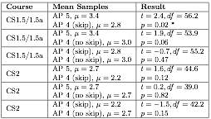
What about AP students?
Average grades in CS 159/240
AP 4 who skipped CS 139/149 did worse in CS 159
Evaluating an Alternative CS1 for Students with Prior Programming Experience
SIGCSE 2017 • Kirkpatrick and Mayfield

Slide 15
Research Hypotheses
CS 159 and CS 240 retention
The split sections improve retention.
The Calculus/B- change led to drop in retention.
✕
✓ / ✕
CS 159 and CS 240 grades
CS 139/149 has no effect on CS 159 or CS 240 grades.
Skip CS 139/149 with AP 4 yields difference in CS 159.
AP 4 + CS 139/149 no difference in CS 159 or CS 240 relative to AP 5.
✕ / ✓
✓
✓
Effect on women and URM students
Split sections improve women/URM retention.
Calculus/B- had disproportionate effect on women/URM.
Evaluating an Alternative CS1 for Students with Prior Programming Experience
SIGCSE 2017 • Kirkpatrick and Mayfield

Slide 16
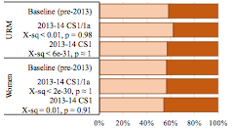
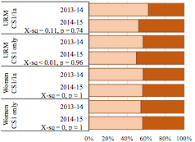
CS 139/149 → CS 159/239 Retention
No effect after accelerated split
No effect after increasing to B-
Evaluating an Alternative CS1 for Students with Prior Programming Experience
SIGCSE 2017 • Kirkpatrick and Mayfield

Slide 17
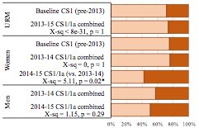
CS 159 → CS 240 Retention
Significant drop in women retention after increasing Calculus requirement...
Evaluating an Alternative CS1 for Students with Prior Programming Experience
SIGCSE 2017 • Kirkpatrick and Mayfield

Slide 18
Research Hypotheses
CS 159 and CS 240 retention
The split sections improve retention.
The Calculus/B- change led to drop in retention.
✕
✓ / ✕
CS 159 and CS 240 grades
CS 139/149 has no effect on CS 159 or CS 240 grades.
Skip CS 139/149 with AP 4 yields difference in CS 159.
AP 4 + CS 139/149 no difference in CS 159 or CS 240 relative to AP 5.
✕ / ✓
✓
✓
Effect on women and URM students
Split sections improve women/URM retention.
Calculus/B- had disproportionate effect on women/URM.
✕
? / ✕
Evaluating an Alternative CS1 for Students with Prior Programming Experience
SIGCSE 2017 • Kirkpatrick and Mayfield

Slide 19
Key Takeaways
Extended intro helps level playing field
No difference by the end of CS2
Extended intro helps students with AP 4
No difference by the end of CS2
Extended intro helps for fair enrollment mgmt
No evidence of prior exposure bias
Evaluating an Alternative CS1 for Students with Prior Programming Experience
SIGCSE 2017 • Kirkpatrick and Mayfield

Slide 20
Thank you
kirkpams@jmu.edu
mayfiecs@jmu.edu

