Slide 1
Meltdown and Spectre:
Complexity and the death of security
Dr. Michael S. Kirkpatrick
January 24, 2018

Slide 2
Meltdown and Spectre:
Wait, my computer does what?
Dr. Michael S. Kirkpatrick
January 24, 2018

Slide 3
Meltdown and Spectre:
Whoever thought that was a good idea?
Dr. Michael S. Kirkpatrick
January 24, 2018

Slide 4
Meltdown and Spectre:
I give up. Can I just retire now?
Dr. Michael S. Kirkpatrick
January 24, 2018

Slide 5
No one alive understands how computers behave.

Slide 7
Meltdown and Spectre
Kernel
co-location
Race
conditions
Page
tables
Cache mapping
Process forks
Branch prediction
Cache hierarchy
Out-of-order execution
Pipelined CPU design
High-resolution timers
Speculative execution
Physical memory map

Slide 8
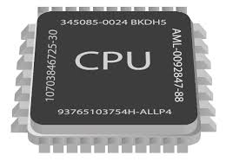
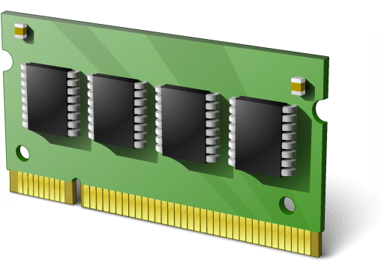

Slide 9
kernel
kernel
✓
✓
stack
stack
iTunes
Page
Table
Chrome
Page
Table
heap
heap
data
Read data location 12345
Read data location 12345
data
code
code

Slide 10
kernel
kernel
stack
stack
iTunes
Page
Table
Chrome
Page
Table
heap
heap
data
data
code
code
Read kernel location deadbeef

Slide 11
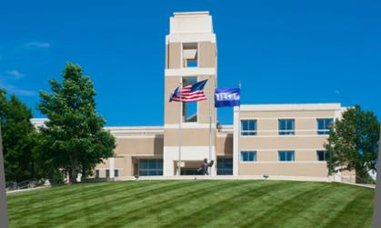
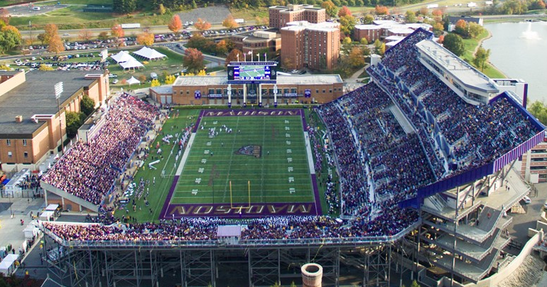
Memory hierarchy and cache
Core 0
Core 3
Regs
Regs
L1
data
cache
L1
inst.
cache
. . .
L1
data
cache
L1
inst.
cache
1: Here’s your data
2: Access allowed?
1: Access allowed?
2: OK, here’s your data
L2 unified cache
L2 unified cache
1: Access allowed?
2: OK, here’s your data
L3 unified cache
(shared by all cores)
1: Access allowed?
2: OK, here’s your data
Main Memory

Slide 12
Fetch
Decode
Execute
Memory
Write back
PC update
Check for
exception
New
PC
Inst. Memory
icode
PC
CC
Cnd
ifun
A
L
U
A
Mem
cntrl
rA
A
d
d
r
valE
Data
Memory
rB
valE
valE
valC
ALU
B
valM
valM
PC incr.
valP
valP
Data
Register file
Register file
valA
valA
A
valA
A
valB
ALU
cntrl
B
valB
B
E
M
E
M

Slide 13
x86 Pipelining
Fetch
Decode
Exec
Mem
Write
PC
Check
Fetch
Decode
Exec
Mem
Write
PC
Check
Fetch
Decode
Exec
Mem
Write
PC
Check
If orange 5 doesn’t depend on 3 & 4, why wait?
Fetch
Decode
Exec
Mem
Write
PC
Check
Fetch
Decode
Exec
Mem
Write
PC
Check
1
2
3
4
5
6
7
8
1
2
1
1
2
2
1
2
3
4
5
6
7
8
3
4
5
4
5
5
3
3
4
1
2
3
4
5
6
7
8
6
7
7
6
6
8
8
7
8

Slide 14
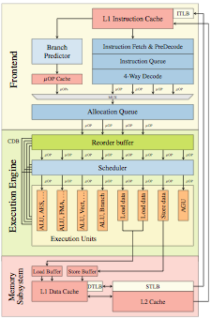
x86 Pipelining
Green and orange can’t “retire” yet
1
2
1
1
2
2
3
4
5
4
5
5
3
3
4
6
7
7
6
6
8
8
7
8

Slide 15
What we know so far…
You’re not supposed to access kernel
L1 cache timing is wrong
x86 pipelining is crazy
Macroarchitecture != microarchitecture
“First” != first
Invisible side effects are visible

Slide 16
Cache-based side channels
Guess what y is!
x = array[y];
0
1
2
3
4
5
6
7
for (i = 0; i < 8; i++) {
start_timer();
y = array[i];
stop_timer();
}

Slide 17
Meltdown
Read a byte of the kernel
Multiply byte by 4096
Use value to hit cache line
8: Maybe I should check if step 4 was valid…

Slide 18
Meltdown
O-ho! Second byte is 1.
Ah! First byte is 2.
ATTACK!
ATTACK!
fork()
fork()

Slide 19
Meltdown
Process memory contains...
the kernel, which contains…
physical memory, which contains…
the memory contents of every process.

Slide 20
x86 Pipelining

Slide 21
Speculative execution
if (x < array_length)
y = array[x];
a
b
c
d
e
f
g
h
x is 2
y becomes c
x is 5
y becomes f
x is 1
y becomes b
x is 327
y becomes

Slide 22
Spectre variant 1
Cache miss
Cache hit
Cache hit
Choose x = &target - &array1
Cache miss
0
1
2
3
4
5
6
7

Slide 23
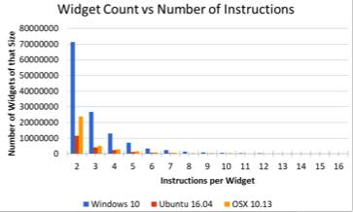
Spectre variant 2 gadgets
https://34c3.cyber-itl.org/slides.pdf

Slide 24
 | Meltdown | Spectre
Short-term fix | KAISER/PTI | Microcode patch (IBPB/STIBP/IBRS) OS update Recompile binaries Change compiler Browser hardening
Long-term fix | Split address space Replace hardware | ????
All BP
Hyperthreading
Change of CPL

Slide 25
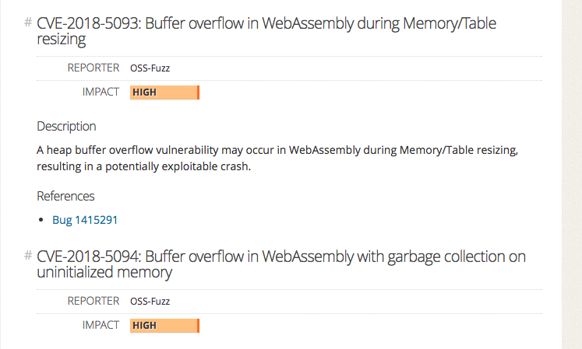

Slide 26
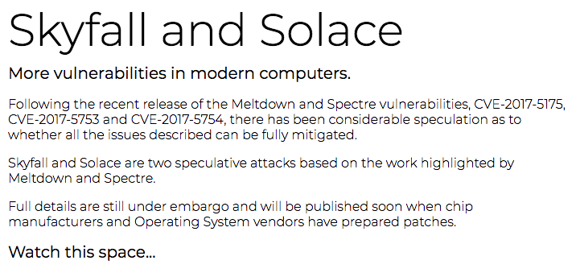
And so it begins…

Slide 27
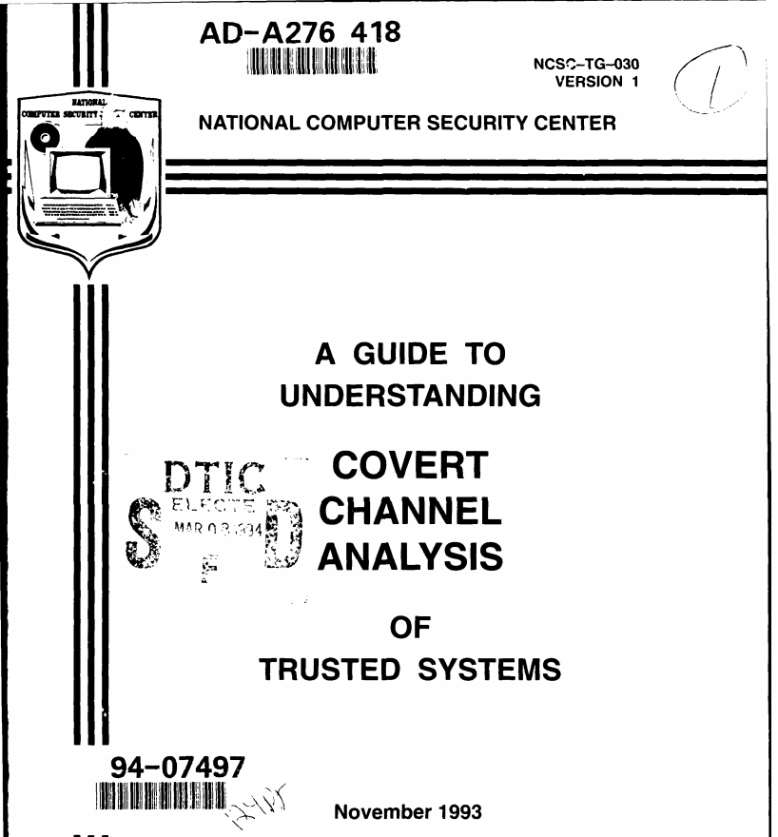
A return to the past…

Slide 28
