Slide 1
Women in Computing:
Good news, bad news, and what can be done (and is!)
Dr. Michael S. Kirkpatrick
Department of Computer Science
March 17, 2016

Slide 2
Pop quiz
Identify the field for the following women:
Jane Goodall
Marie Curie
Rosalind Franklin
Margaret Mead
Rachel Carson
Barbara McClintock
Lise Meitner
Emmy Noether
Sofia Kovaleskaya
biology
chemistry
chemistry
Now name a female
computer scientist
anthropology
biology
genetics
physics
physics
mathematics
JMU ISAT 485: Gender Issues in Science
Spring 2016 • Dr. Michael S. Kirkpatrick

Slide 3
What is Computer Science and why should you care?
JMU ISAT 485: Gender Issues in Science
Spring 2016 • Dr. Michael S. Kirkpatrick

Slide 4
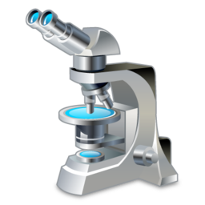
= Computer Science
Computer science is the systematic study of automating the processing of information
if and only if
= Chemistry
JMU ISAT 485: Gender Issues in Science
Spring 2016 • Dr. Michael S. Kirkpatrick

Slide 5
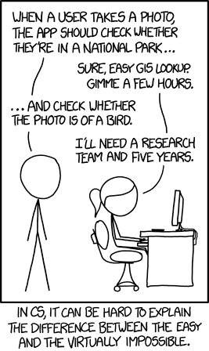
JMU ISAT 485: Gender Issues in Science
Spring 2016 • Dr. Michael S. Kirkpatrick

Slide 6
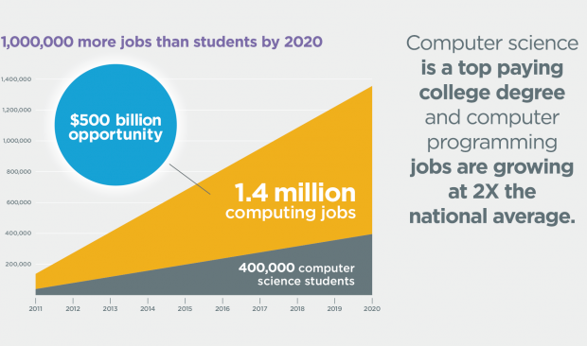
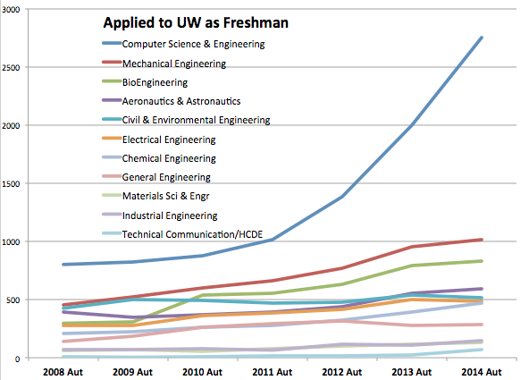
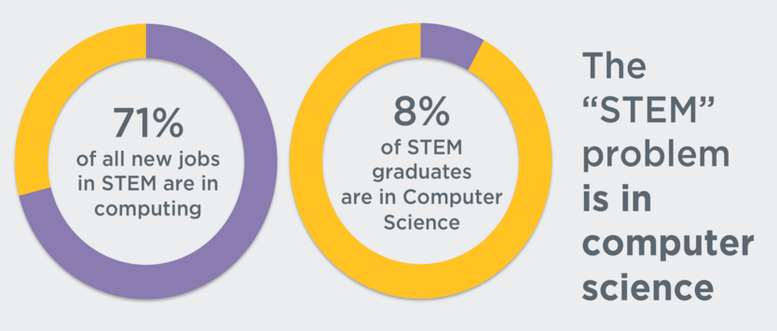
JMU ISAT 485: Gender Issues in Science
Spring 2016 • Dr. Michael S. Kirkpatrick

Slide 7
Good news
JMU ISAT 485: Gender Issues in Science
Spring 2016 • Dr. Michael S. Kirkpatrick

Slide 8
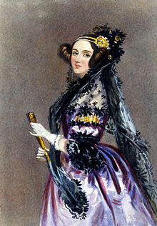
Ada Lovelace
1815 - 1852
English mathematician
Notes on Charles Babbage’s Analytical Engine recognized as the first automated algorithm
World’s first programmer
JMU ISAT 485: Gender Issues in Science
Spring 2016 • Dr. Michael S. Kirkpatrick

Slide 9
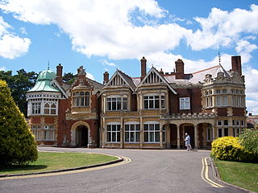
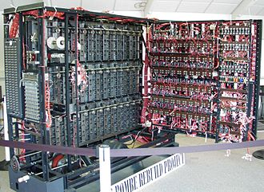
Bletchley Park
World War II
UK Government Code & Cipher School
Broke secret communications of
the Axis Powers
Home of the world’s first programmable computer
80% of the 12,000 workers were women
JMU ISAT 485: Gender Issues in Science
Spring 2016 • Dr. Michael S. Kirkpatrick

Slide 10
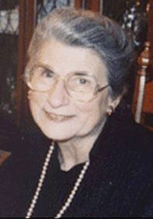
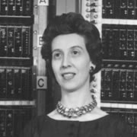
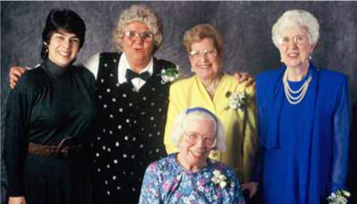
ENIAC Six (Top Secret Rosies)
Jean Bartik, Marlyn Meltzer, Kay Antonelli, Betty Holberton, Ruth Teitelbaum, Fran Spence
Programmed one of the first general-purpose computers
Trained themselves to program ENIAC based on its hardware diagram
Used to calculate the feasibility of a thermonuclear weapon
JMU ISAT 485: Gender Issues in Science
Spring 2016 • Dr. Michael S. Kirkpatrick

Slide 11
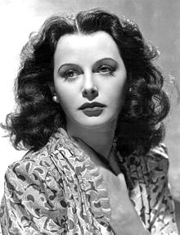
Hedy Lamarr
1914 - 2000
American actress
Co-invented frequency-hopping spread-spectrum to avoid jamming of radio-controlled torpedos in WWII
Critical technology in Bluetooth
JMU ISAT 485: Gender Issues in Science
Spring 2016 • Dr. Michael S. Kirkpatrick

Slide 12
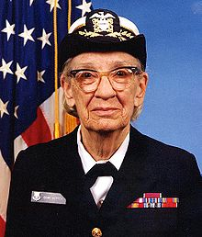
Grace Murray Hopper
1906 - 1992
American mathematician
U.S. Navy Rear Admiral
Oldest active-duty commissioned officer in U.S. Navy history
Invented the first compiler
Popularized the term “bug”
Pioneered for standards in computer systems
Translates code into machine language
JMU ISAT 485: Gender Issues in Science
Spring 2016 • Dr. Michael S. Kirkpatrick

Slide 13
Grace Murray Hopper
It’s easier to ask forgiveness than it is to get permission.
Humans are allergic to change. They love to say, “We’ve always done it this way.” I try to fight that. That’s why I have a clock on my wall that runs counter-clockwise.
https://en.wikiquote.org/wiki/Grace_Hopper
JMU ISAT 485: Gender Issues in Science
Spring 2016 • Dr. Michael S. Kirkpatrick

Slide 14
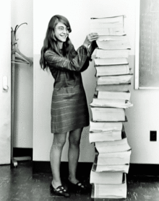
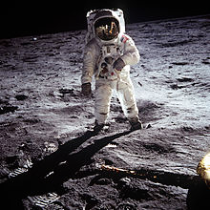
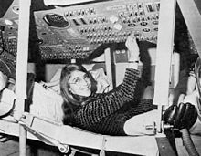
Margaret Hamilton
1936 -
American computer scientist and engineer
Popularized “software engineering”
Developed asynchronous software, priority scheduling, end-to-end testing, and human-in-the-loop decision capability
Her code saved the Apollo 11 landing
JMU ISAT 485: Gender Issues in Science
Spring 2016 • Dr. Michael S. Kirkpatrick

Slide 15
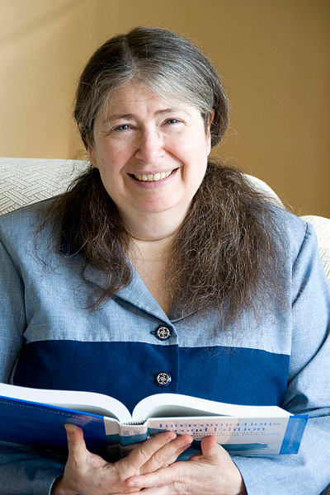
Radia Perlman
1951 -
American computer scientist
Developed a language to teach toddlers programming
Invented spanning-tree protocols, techniques for routing when under attack
“Mother of the Internet”
JMU ISAT 485: Gender Issues in Science
Spring 2016 • Dr. Michael S. Kirkpatrick

Slide 16
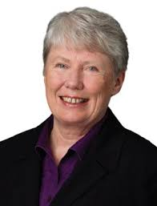
Maria Klawe
1951 -
Canadian computer scientist
President of Harvey Mudd
CS department is 50% women
Key contributions to computational geometry
Studies gender in gaming
Founder of Aphasia Project
Use computers for disability support
JMU ISAT 485: Gender Issues in Science
Spring 2016 • Dr. Michael S. Kirkpatrick

Slide 17
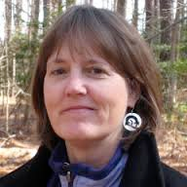
Jan Cuny
?? -
American computer scientist
NSF Program Officer
Leading efforts of #cs4all
Highlighted in 2016 State of the Union Adress
JMU ISAT 485: Gender Issues in Science
Spring 2016 • Dr. Michael S. Kirkpatrick

Slide 18
Honorable mentions
Many other influential technologists
Marissa Mayer
Sheryl Sandberg
Meg Whitman
Carly Fiorina
Ginni Rometty
Anita Borg
Lynn Conway
Fran Allen
Shafi Goldwasser
Barbara Liskov
Sister Mary Kenneth Keller
Janie Tsao
Jane Prey
Susan Horwitz
Susan Rodger
Valerie Barr
Adele Goldstine
danah boyd
- Facebook COO
- eBay CEO
- HP CEO
- IBM CEO
JMU ISAT 485: Gender Issues in Science
Spring 2016 • Dr. Michael S. Kirkpatrick

Slide 19
Bad news
JMU ISAT 485: Gender Issues in Science
Spring 2016 • Dr. Michael S. Kirkpatrick

Slide 20
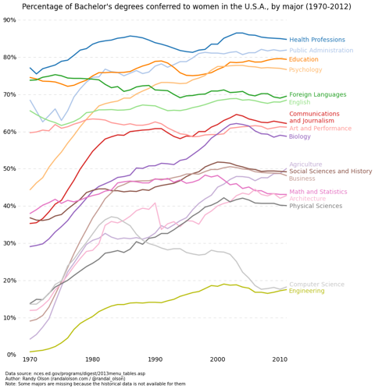
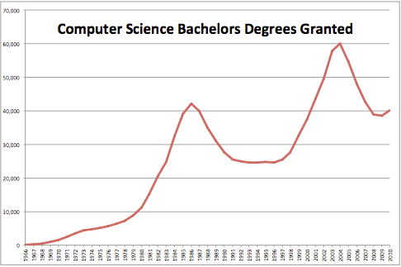
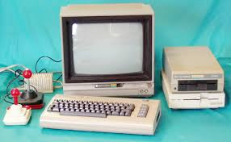
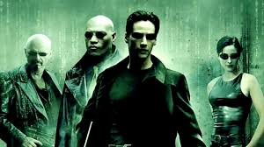
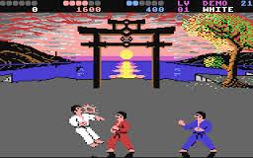
Enrollment boom led to de facto pro-white-male quotas
Rise of hacker and geek status
JMU ISAT 485: Gender Issues in Science
Spring 2016 • Dr. Michael S. Kirkpatrick

Slide 21
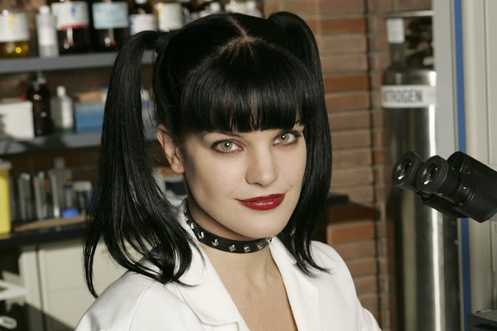
Obstacles and debacles
ALL CS is cooperative teamwork
False impressions (“The Pipeline Problem”)
Pop culture image of programmers as loners and hackers
Intro courses are misleading, reinforce stereotypes
CS courses miss social context
Overrepresentation of hacking
Overrepresentation of gaming
Overstated concerns of outsourcing
Misunderstanding of what CS entails
JMU ISAT 485: Gender Issues in Science
Spring 2016 • Dr. Michael S. Kirkpatrick

Slide 22
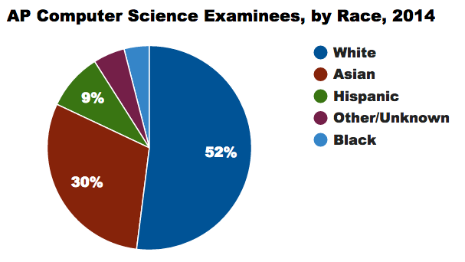
Obstacles and debacles
JMU ISAT 485: Gender Issues in Science
Spring 2016 • Dr. Michael S. Kirkpatrick

Slide 23
Obstacles and debacles
JMU ISAT 485: Gender Issues in Science
Spring 2016 • Dr. Michael S. Kirkpatrick

Slide 24
Obstacles and debacles
Unwelcoming culture (“The Leaky Pipeline”)
Hackathons - Titstare
Strip show at Black Hat
RSA Conference “booth babes”
Julie Ann Horvath’s departure
Brogrammer culture
Sarah Sharp vs. Linus Torvalds
Tropes vs. Women
#gamergate
startup
hacking
hacking
startup
startup
startup
gaming
gaming
JMU ISAT 485: Gender Issues in Science
Spring 2016 • Dr. Michael S. Kirkpatrick

Slide 25
Subcultures
Computer
Science
start-up
hacking
gaming
JMU ISAT 485: Gender Issues in Science
Spring 2016 • Dr. Michael S. Kirkpatrick

Slide 26
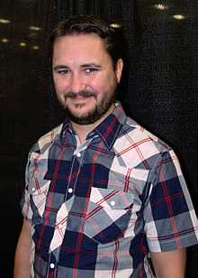
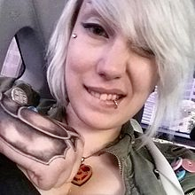
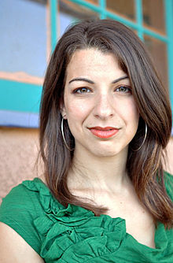
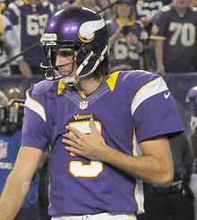
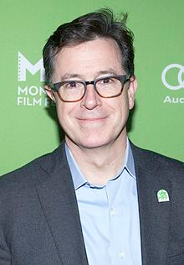
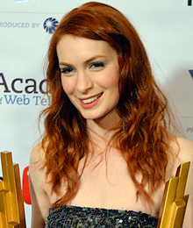
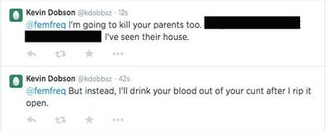
Obstacles and debacles
Targets of #gamergate harrassment/threats
Not targets
JMU ISAT 485: Gender Issues in Science
Spring 2016 • Dr. Michael S. Kirkpatrick

Slide 27
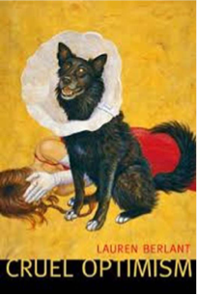
Misleading hope
https://www.ncwit.org/video/2015-ncwit-summit-%E2%80%93-plenary-i-glass-slipper-leaning-in%E2%80%A6-evidence-gender-and-professions-karen
JMU ISAT 485: Gender Issues in Science
Spring 2016 • Dr. Michael S. Kirkpatrick

Slide 28
What can be done
JMU ISAT 485: Gender Issues in Science
Spring 2016 • Dr. Michael S. Kirkpatrick

Slide 29
What WE can do (and are!)
Change CS courses
Combat sources of gender bias and stereotype threat
Pair programming; mixed-gender collaborations
Welcoming and supportive intro courses
Emphasize computing for social good
Encourage persistence and growth mindset
Research experiences
JMU ISAT 485: Gender Issues in Science
Spring 2016 • Dr. Michael S. Kirkpatrick

Slide 30
What WE can do (and are!)
Advocate for women and persons of color in tech
Listen without interrupting; avoid mansplaining
Recognize intersectional problems and implicit bias
Change motivation and rationale:
NO: Women deserve inclusion in field with great job opportunities
YES: Computing & tech should reflect the plurality of our world
Use status to raise awareness
Call out sexism, racism, and other bad social behavior
JMU ISAT 485: Gender Issues in Science
Spring 2016 • Dr. Michael S. Kirkpatrick

Slide 31
What YOU can do
Be a role model
Learn to code and use computational thinking
Attend a Girl Develop It Meetup
Encourage young girls to code
Support #cs4all
Consider CS-related outreach career opportunities
Talk about women in technology
Cultivate privilege traitors
Speak out*
*Easier said than done
JMU ISAT 485: Gender Issues in Science
Spring 2016 • Dr. Michael S. Kirkpatrick

Slide 32
What OTHERS are doing (and YOU could, too!)
JMU ISAT 485: Gender Issues in Science
Spring 2016 • Dr. Michael S. Kirkpatrick

Slide 33
Questions?
JMU ISAT 485: Gender Issues in Science
Spring 2016 • Dr. Michael S. Kirkpatrick

Slide 34
Resources
Where to go for more information
National Council for Women & IT (http://www.ncwit.org/)
ACM’s Women in Computing (ACM-W) (http://women.acm.org/)
Anita Borg Institute (http://anitaborg.org/)
Girls Who Code (http://girlswhocode.com/)
Black Girls Code (http://blackgirlscode.com/)
Girl Develop It (http://girldevelopit.com/)
Code2040 (http://code2040.com/)
Hour of Code and Code.org (http://code.org/)
CODE: Debugging the Gender Gap (http://www.codedocumentary.com/)
Learn to write Python code:
http://www.codecademy.com/en/tracks/python
http://learnpython.org/
JMU ISAT 485: Gender Issues in Science
Spring 2016 • Dr. Michael S. Kirkpatrick

