Slide 1
Women in Computing:
Past, Present, and Future
Dr. Michael S. Kirkpatrick
Department of Computer Science
April 10, 2019

Slide 2
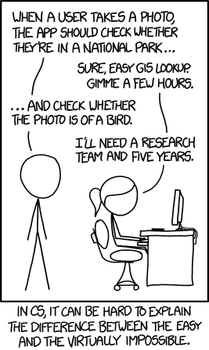

Slide 3
What is Computer Science and why should you care?

Slide 4
= Computer Science
if and only if
= Chemistry

Slide 5
Computer Science is...
the systematic study of the feasibility, structure, expression, and automation of the methodical procedures (or algorithms) that underlie the acquisition, representation, processing, storage, communication of, and access to information

Slide 6
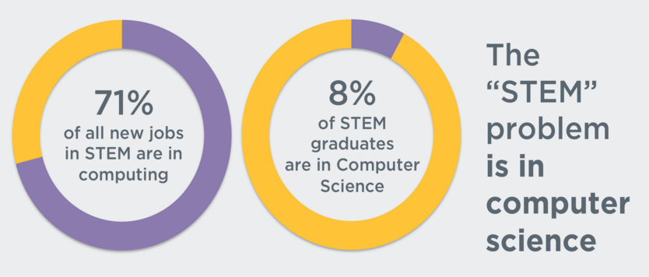
Computer Science is...
Mobile application developer
Risk management director
Landman
Product analyst
Information assurance analyst
Quality assurance coordinator (RN)
Clinical applications specialist
Hospital administrator
Database analyst
Director of finance and administration
https://money.cnn.com/pf/best-jobs/

Slide 7
Computer Science is...
a foundational skill for the 21st century

Slide 8
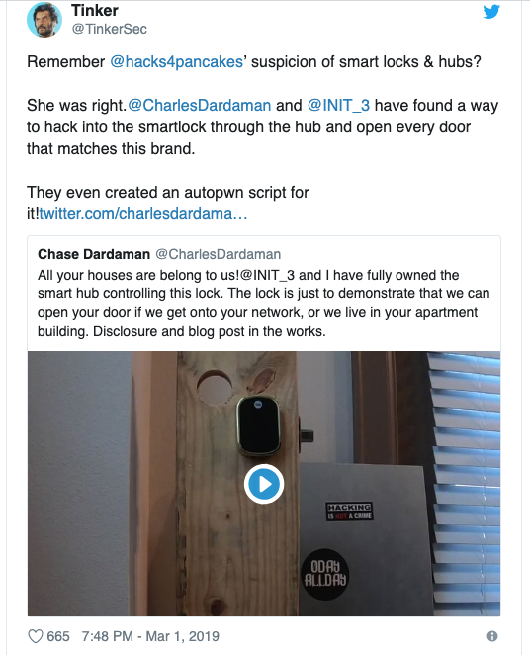
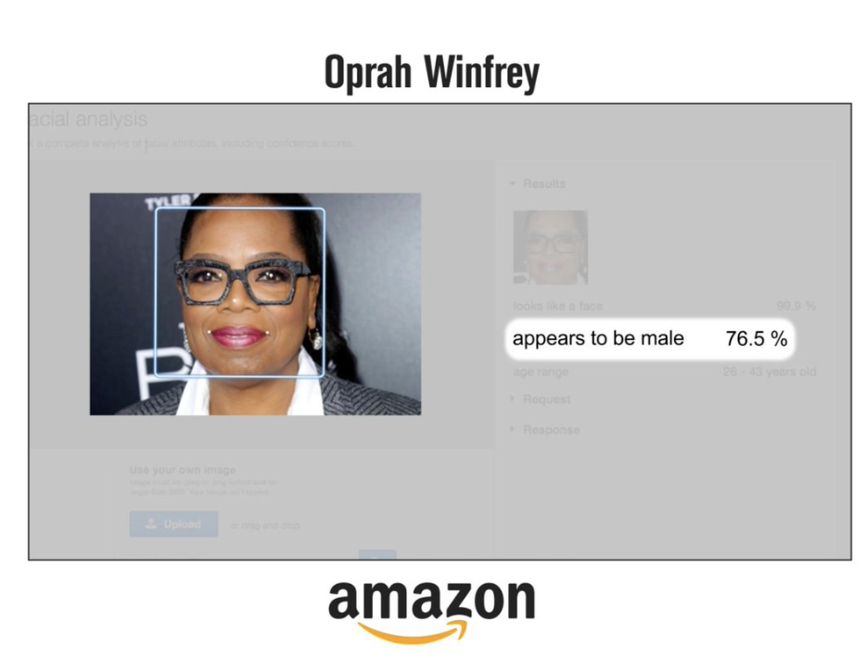

Slide 9
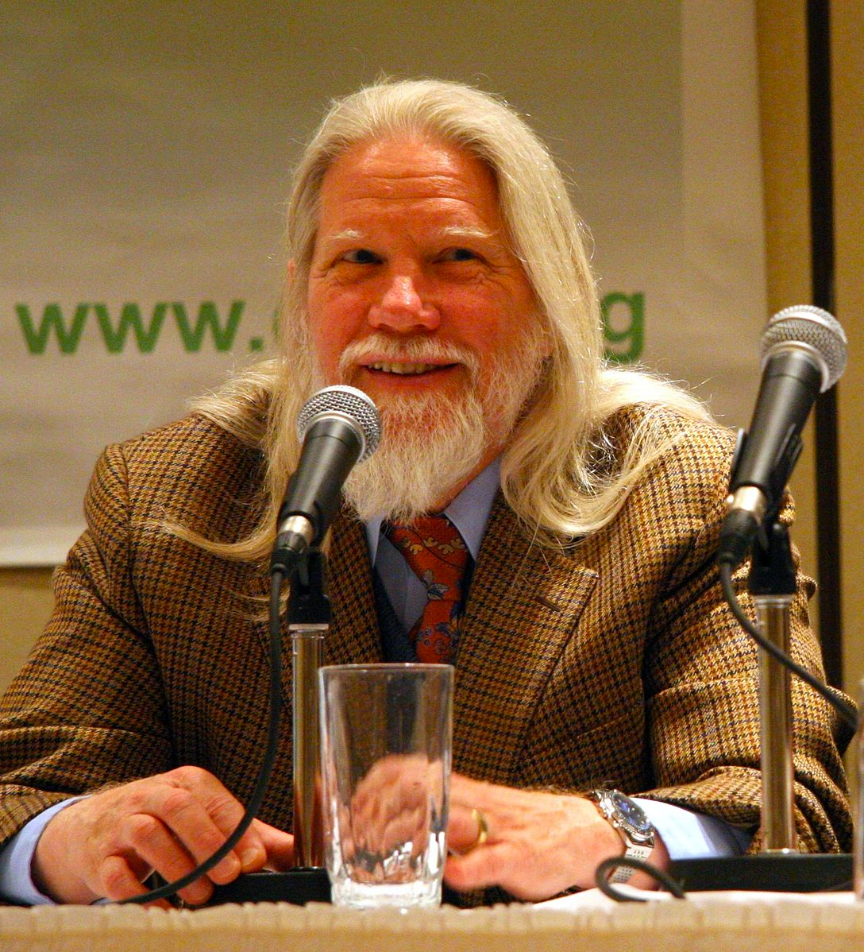
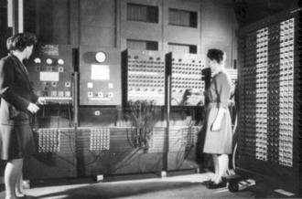
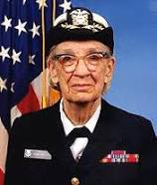
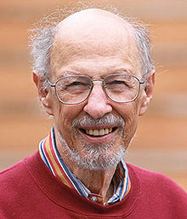
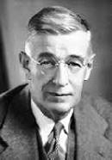
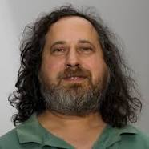
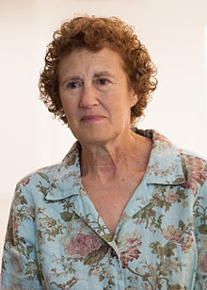
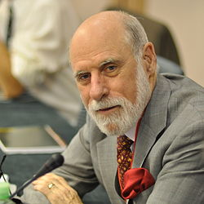
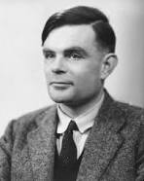
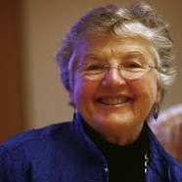
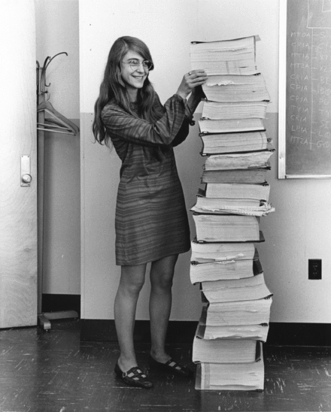
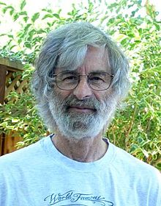
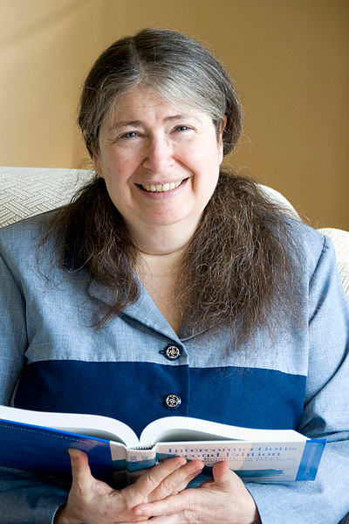
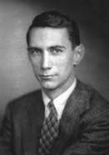
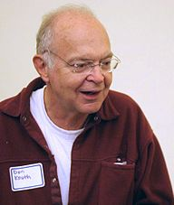
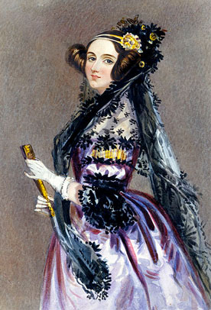
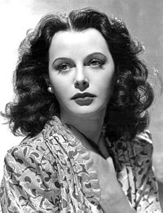
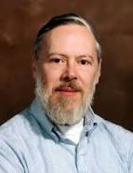
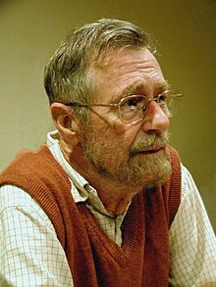
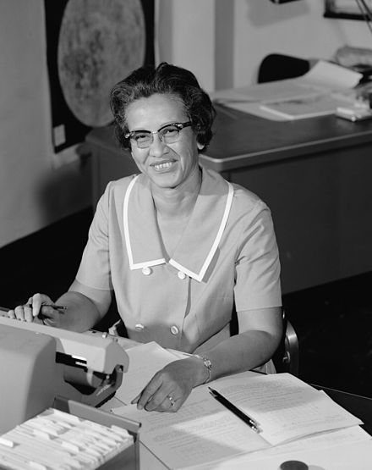
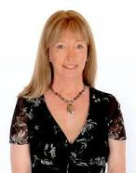

Slide 10
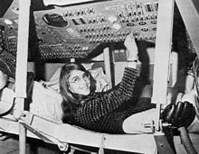
Barbara Liskov’s work is the foundation of moden software design
Frances Allen made optimizing compilers possible
Grace Hopper…
Radia Perlman invented key parts of the Internet
Margaret Hamilton’s code saved the “giant leap for mankind”
Ada Lovelace wrote the world’s first computer program
Hedi Lamarr’s invention made Bluetooth possible

Slide 11
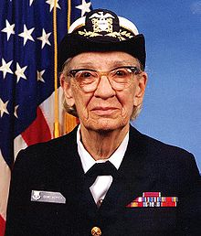
Rear Admiral Grace M. Hopper
It’s easier to ask forgiveness than it is to get permission.
In total desperation, I called over to the engineering building, and I said, "Please cut off a nanosecond and send it over to me."
Humans are allergic to change. They love to say, “We’ve always done it this way.” I try to fight that. That’s why I have a clock on my wall that runs counter-clockwise.
https://en.wikiquote.org/wiki/Grace_Hopper

Slide 12
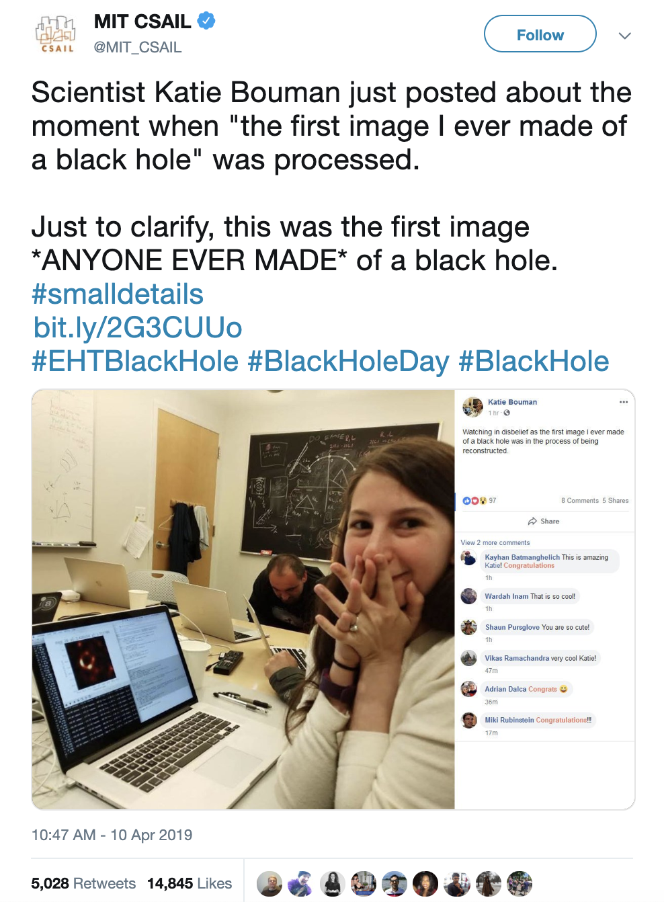

Slide 13
I reject this premise…

Slide 15
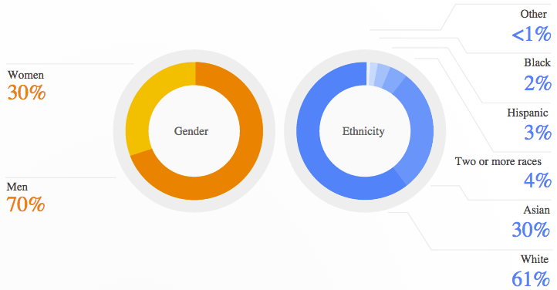
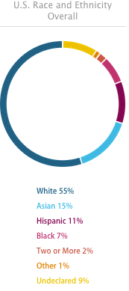
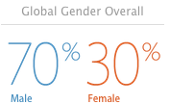
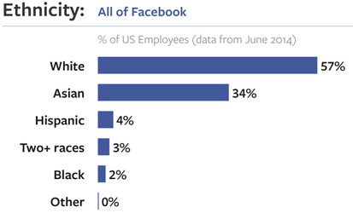

Slide 16
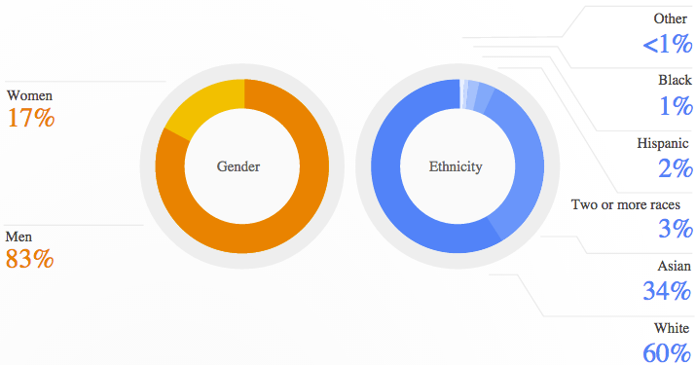
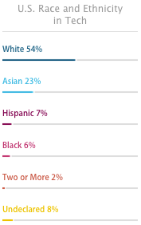
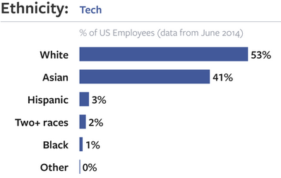
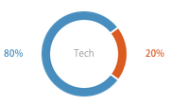

Slide 17
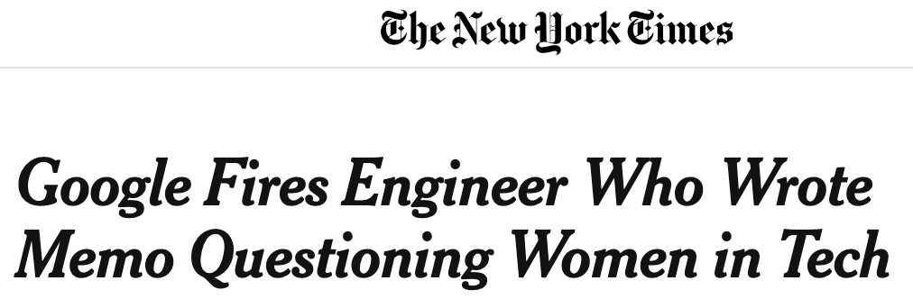

Slide 18
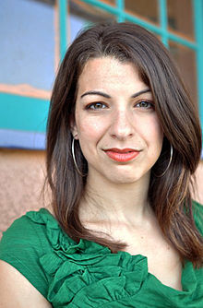
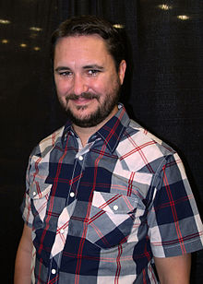
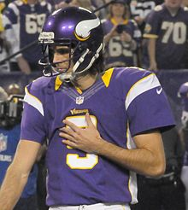
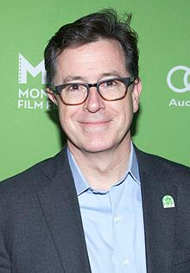
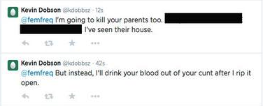
Targets of #gamergate harrassment/threats
Not targets

Slide 19
“It's difficult to even get a modicum of respect. They talk down to you. They belittle you.”
“It is not misogyny to tell a sexist joke, or to fail to take a woman seriously…”
“I’m honestly trying to understand why anyone says that females are ‘needed’ in the tech industry. The tech community works fine without females, just like any other mostly male industry. Feminists probably just want women making more money.”
“This is an industry filled with sociopaths who cannot see another individual as a human being.”

Slide 20
The leaky pipeline:
“The pipeline is leaky and full of acid. The pipeline leads to a sewage treatment plant. The pipeline ends in a meat grinder.”
-Julie Pagano*
*Diversity for Sale (http://juliepagano.com/blog/2015/02/07/diversity-for-sale/)

Slide 21
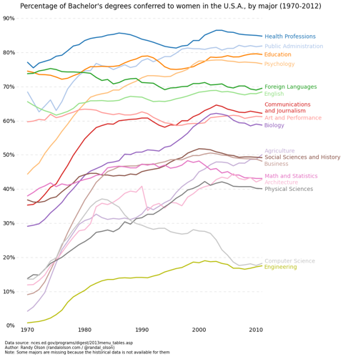
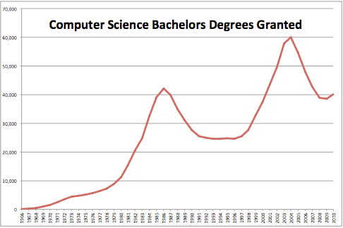
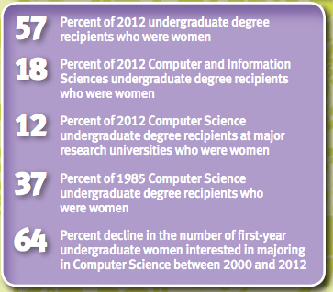
http://ncwit.org/

Slide 22
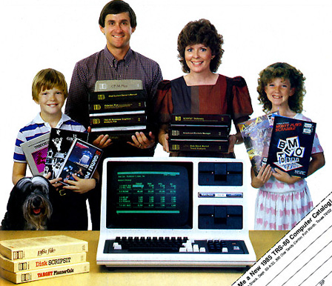
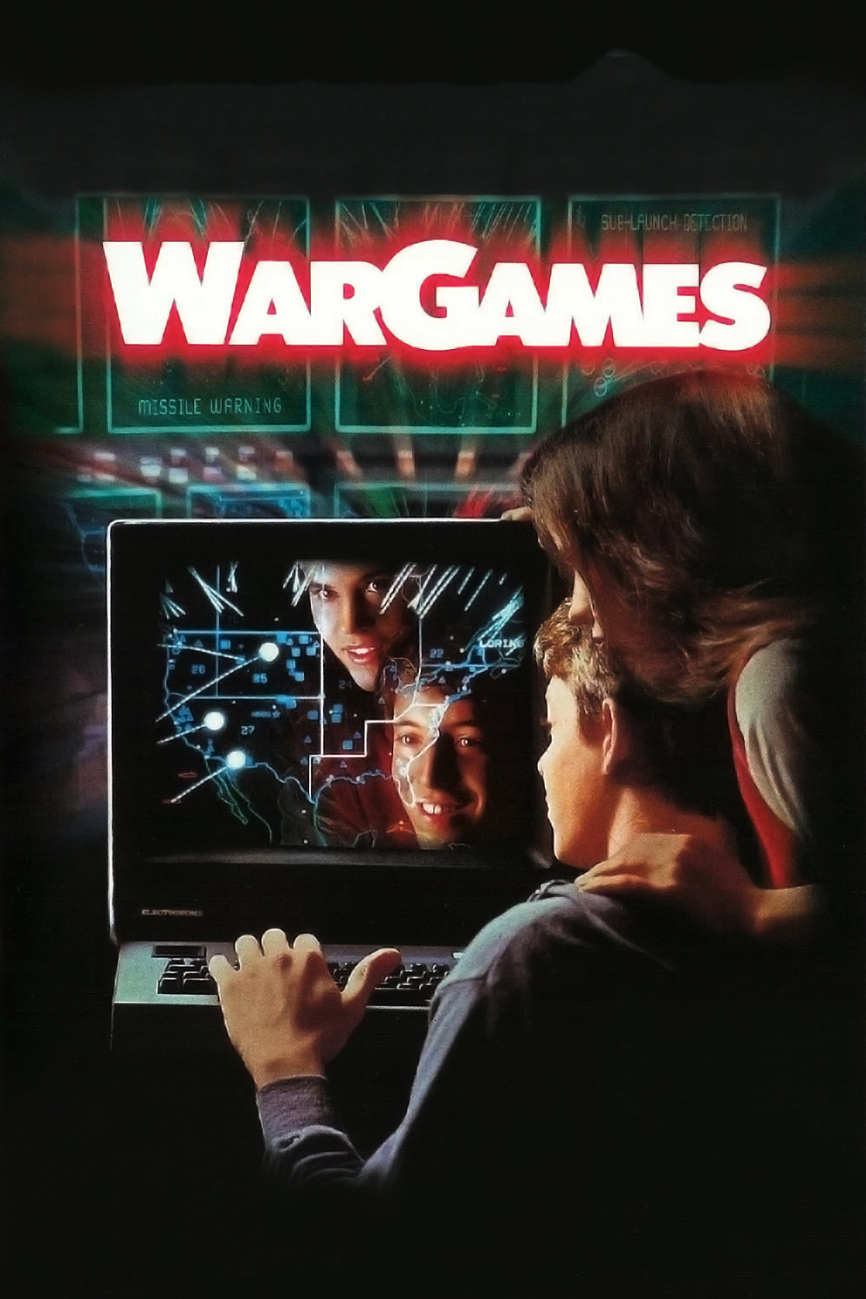
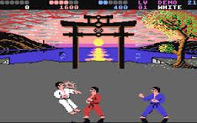
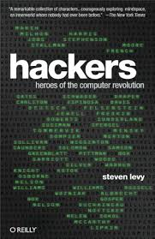
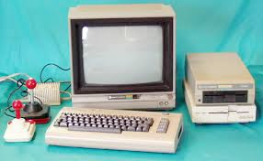
1980s: The “Golden Age”

Slide 24
Level playing field?

Slide 25
90s/00s: Y2K, Dot-com boom/bust

Slide 26
Now: The Third Surge
“One category of reactions that I receive all the time as a programmer that presents as feminine is: No one believes I am a programmer. I can’t tell you how many people, when meeting me and hearing my profession, tell me that I look like a designer, someone in accounting, someone in marketing, anything but a programmer.”

Slide 27
Steered away by parents, teachers, others
“Computing is for boys”
Underrepresentation is a vicious cycle
Lack of role models
Girls systematically underestimate their abilities
Accurate feedback is critical
Girls anticipate work-family conflicts
Discrimination limits opportunities
Punished for exhibiting competence
Girls’ choices are constrained
Cheryan, S., Master, S., and Metzloff, A.N. “Cultural stereotypes as gatekeepers: increasing girls’ interest in computer science and engineering by diversifying stereotypes.” Frontiers in Psychology, 11 February 2015,
http://journal.frontiersin.org/article/10.3389/fpsyg.2015.00049/full.

Slide 28
Misleading hope
https://www.ncwit.org/video/2015-ncwit-summit-%E2%80%93-plenary-i-glass-slipper-leaning-in%E2%80%A6-evidence-gender-and-professions-karen

Slide 30
There is no
“tech industry”

Slide 39
Thank you!

Slide 40
Where to go for more information
National Council for Women & Information Technology (http://www.ncwit.org/)
ACM’s Women in Computing (ACM-W) (http://women.acm.org/)
CS10K Project (http://cs10kcommunity.org/)
Code.org (http://code.org/)
Anita Borg Institute (http://anitaborg.org/)
Girls Who Code (http://girlswhocode.com/)
Black Girls Code (http://blackgirlscode.com/)
Model View Culture (https://modelviewculture.com/)
Learn to write Python code:
http://www.codecademy.com/en/tracks/python
http://learnpython.org/

Slide 41
Where to go for more information
Alice (http://alice.org/)
AppInventor (http://appinventor.mit.edu/)
Computer Science Unplugged (http://csunplugged.org/)
Finch Robots (http://finchrobot.com/)
Lightbot (http://lightbot.com/)
Scratch (http://scratch.mit.edu/)
Snap! (Build Your Own Blocks) (http://snap.berkeley.edu/)
Girl Develop It (https://www.girldevelopit.com/)
TEALS (https://www.tealsk12.org/)
Bootstrap (http://www.bootstrapworld.org/)
Code 2040 (http://www.code2040.org/)
Code Nation (https://codenation.org/)

Slide 42
Recommendations

