Slide 1
Toward Successful Cooperative Learning
Enhancing small-group work
Michael S. Kirkpatrick
Center for Faculty Innovation

Slide 2
Why and why not?

Slide 3
Learning is…
Abilities
Knowledge
Retrieval
Application
CHANGE
Attitudes
AREA OF INQUIRY
Feedback
Factual knowledge
METACOGNITION
Context
Progress
Practice

Slide 4
GOOD
BAD
R
I
S
E
etrieval practice
assive observation
P
R
I
Ma
L
nterleaving
ereading texts
pacing
ntuitive judgments
laboration
ssed practice
Deliberative effort
Pre-learning
Growth mindset
Metacognition
earning styles

Slide 5
The good, the bad,
and the ugly…

Slide 6
Positive interdependence
Accountability
Successful cooperative learning
Face-to-face interactions
Group processing and reflection
Team-work skills

Slide 7
Building interdependence
Are multiple perspectives necessary?
Does it support learning outcomes?
Is divide-and-conquer impossible?
Do they have necessary skills and resources?

Slide 8
Group formation
Random
Self
Selection
Assigned
Diverse/ heterogeneous
Distributed
Skills
Similar/homogeneous
Representation
Grouped

Slide 9
Stages of Group Dynamics
expectations
goals
trust
Forming

Slide 10
Stages of Group Dynamics
power/control
communication
reacting
expectations
goals
trust
Storming
Forming

Slide 11
Stages of Group Dynamics
roles
problem-solving
consensus
power/control
communication
reacting
Norming
expectations
goals
trust
Storming
Forming

Slide 12
Stages of Group Dynamics
identity
satisfaction
care
roles
problem-solving
consensus
Performing
power/control
communication
reacting
Norming
expectations
goals
trust
Storming
Forming

Slide 13
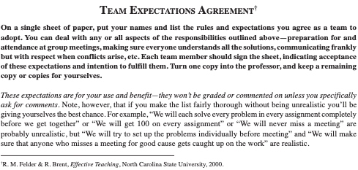
Establishing norms

Slide 14
Establishing norms

Slide 15
Team-player Styles
Contributor
Focus on the immediate task

Slide 16
Team-player Styles
Contributor
Collaborator
Focus on the immediate task
Emphasize the overall purpose of team

Slide 17
Team-player Styles
Contributor
Collaborator
Focus on the immediate task
Emphasize the overall purpose of team
Communicator
Positive interpersonal relations, processes

Slide 18
Team-player Styles
Contributor
Collaborator
Focus on the immediate task
Emphasize the overall purpose of team
Communicator
Challenger
Positive interpersonal relations, processes
Ask tough questions and pushes for risks

Slide 19
Group formation
http://my.safaribooksonline.com/book/teamwork/9780787998110/resources-
tools-for-developing-teams-and-team-players/resources_tools_for_developing

Slide 20
Active listening
Conflict resolution
Constructive criticism
Interpersonal skills
Consensus vs. compromise
Label behaviors, not people
Testing for mastery

Slide 21
Stages of Skill Development
Awareness of need

Slide 22
Stages of Skill Development
Comprehension of what skill is
Awareness of need

Slide 23
Stages of Skill Development
Awkward feelings applying skill
Comprehension of what skill is
Awareness of need

Slide 24
Stages of Skill Development
Mechanical use of skill
Awkward feelings applying skill
Comprehension of what skill is
Awareness of need

Slide 25
Stages of Skill Development
Automatic use of skill
Mechanical use of skill
Awkward feelings applying skill
Comprehension of what skill is
Awareness of need

Slide 26
Common roles
Leader/manager/organizer
Recorder
Materials manager/technician
Skeptic/questioner
Reflector
Time keeper
Reader
Reporter
Checker

Slide 27
Who…
What…
specific evaluators
quantitative vs. qualitative
When…
Peer Evaluations
early or late?
Why…
How…
judge or improve?
impact on grades

Slide 28
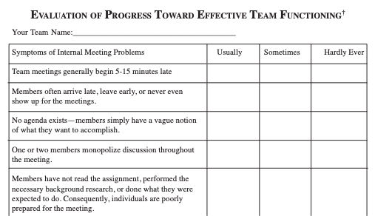
Early Group Evaluation

Slide 29
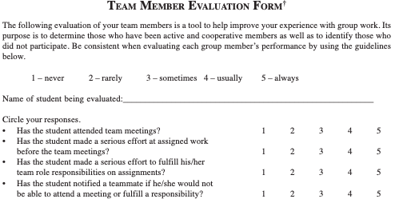
Summative Evaluation

Slide 30
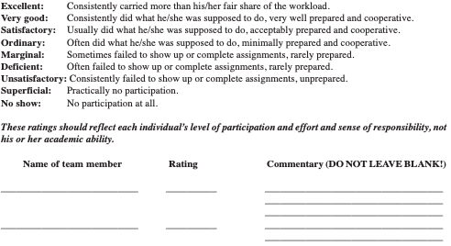
Summative Evaluation

Slide 31
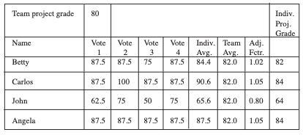
Summative Evaluation

Slide 32
Hitchhikers and couch potatoes
Name | Rating | Commentary
Mary | Ordinary | Not good at problem solving, but she tries hard and gets extra help from the professor.
Henry | Marginal | Irritating. He’s a nice guy, but he doesn’t put in the effort. He’ll sheepishly hand over partially worked homework problems and confess to spending the weekend watching TV.
Jack | Unsatisfactory | When we tried to set up meetings, he was too busy. He rarely turns in his part of the homework and it’s normally wrong. He never answers phone messages, then denies getting them. He never responds to email and misses every meeting, so we just stopped inviting him. He constantly complains about his 50-hour work weeks, heavy school load, bad textbooks, and terrible teachers. He blames everybody else for his problems.

Slide 33
Hitchhikers and couch potatoes
Name | Rating | Commentary
Mary | Ordinary | Not good at problem solving, but she tries hard and gets extra help from the professor.
Henry | Marginal | Irritating. He’s a nice guy, but he doesn’t put in the effort. He’ll sheepishly hand over partially worked homework problems and confess to spending the weekend watching TV.
Jack | Unsatisfactory | When we tried to set up meetings, he was too busy. He rarely turns in his part of the homework and it’s normally wrong. He never answers phone messages, then denies getting them. He never responds to email and misses every meeting, so we just stopped inviting him. He constantly complains about his 50-hour work weeks, heavy school load, bad textbooks, and terrible teachers. He blames everybody else for his problems.
self | Excellent | I pretty much did all of the work myself. I showed up at the first few meetings and nobody else had a clue what was going on. After that, I just started doing everything, so our meetings were just me explaining stuff to them.

Slide 34
Peer evaluation
Use formative for early problem solving
Quantitative must be measurable
Complement quantitative with qualitative
Summative must include self-evaluation
Be aware of group dynamics

Slide 35
The good, the bad,
and the ugly…

