Slide 1
Getting Started with
Specifications Grading
Michael S. Kirkpatrick
JMU Computer Science and CFI
May Symposium 2019

Slide 2
A traditional scheme
iRAT/tRAT are readiness tests taken first day of each module
Each project has specific deadline (10% penalty for up to 48 hours late)
Make-up exams only for documented excused absence
 | Weight
iRAT | 10%
tRAT | 10%
Reflections | 5%
Team projects | 35%
Midterm exam | 15%
Final exam | 25%

Slide 3
Barre, E. (2016) “Meaningful, moral, and manageable? The grading holy grail”.
https://cte.rice.edu/blogarchive/2016/2/9/grading

Slide 4
Why grade?
[We have to…]
Fun?
Learning?
Predictor of success?
Motivation?
Barre, E. (2016) “Meaningful, moral, and manageable? The grading holy grail”.
https://cte.rice.edu/blogarchive/2016/2/9/grading

Slide 5
Credit: Dr. Kenn Barron, JMU Motivation Research Institute

Slide 6
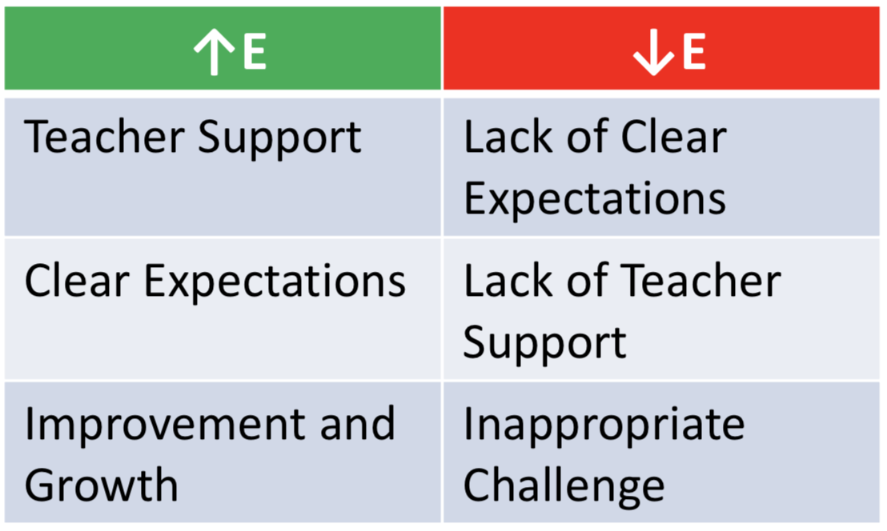
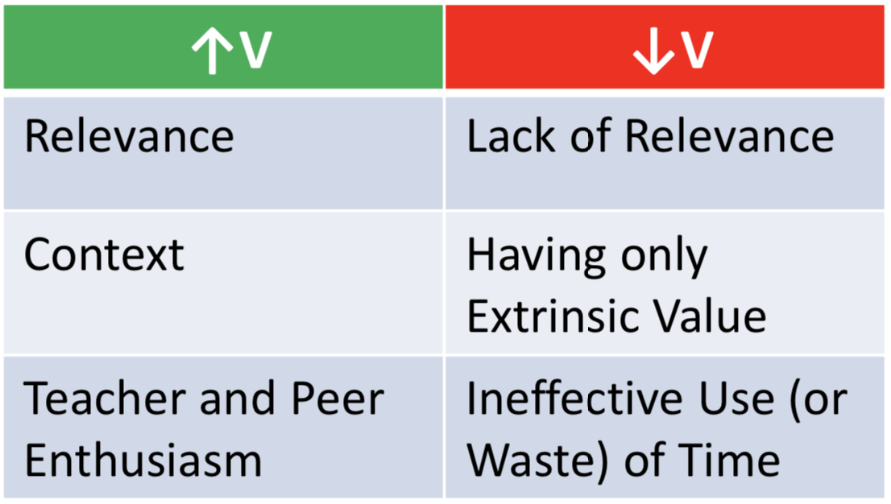
Credit: Dr. Kenn Barron, JMU Motivation Research Institute

Slide 7
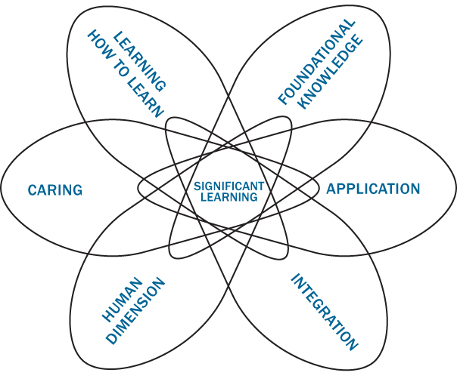
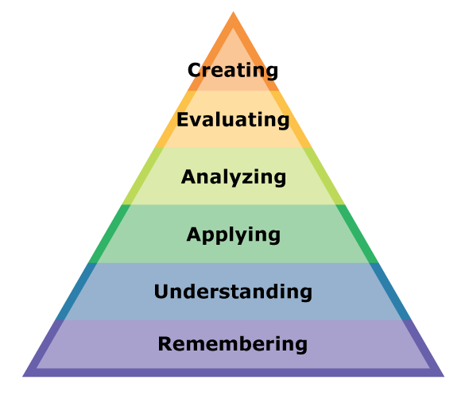
Learning outcomes
Self-knowledge
Explanation
Empathy
Interpretation
Perspective
Application

Slide 8
Learning outcomes
Build safe and efficient concurrent software systems
Cultivate a sense of identity as a computing professional
Evaluate the root cause of complex system failures
Articulate the tradeoffs induced by design choices

Slide 9
Specifications Grading
Specifications
One-level pass/fail rubrics

Slide 10
Specifications Grading
Specifications
One-level pass/fail rubrics
Feedback
Early and formative

Slide 11
Specifications Grading
Specifications
One-level pass/fail rubrics
Feedback
Early and formative
Bundles
Grouping of tasks or assignments

Slide 12
Specifications Grading
Specifications
One-level pass/fail rubrics
Feedback
Early and formative
Bundles
Grouping of tasks or assignments
Tokens
[Optional] Drops, resubmits, late days, etc.

Slide 13
Point-based specs grading
 | Weight
Reading | 17
Written assignments | 40
Self-regulated learning | 8
Creative project | 10
Midterm exam | 10
Final exam | 15
Reading quizzes + homeworks worth 1 point each
Written assignments (analysis, reports) worth 10 points each
Self-regulated/metacognitive learning activities (exam corrections, muddy points) worth 2 points each
Creative project can be individual or group

Slide 14
Credit: Dr. Kenn Barron, JMU Motivation Research Institute

Slide 15
Horizontal bundling
Bundle 1
Bundle 2
Bundle 3
Bundle 4
Bundle 5
Reading analyses
Homework problems
Annotated bibliography
Project
live demo
Analysis paper
2 bundles = D 3 bundles = C 4 bundles = B 5 bundles = A

Slide 16
Hierarchical bundling
All B requirements plus
Project analysis paper
Solve 6 total final exam problems
A
All C requirements plus
Project implementation and working demo
Solve 4 total final exam problems
B
All D requirements plus
Complete 4 of the 5 lab exercises
Solve 3 total final exam problems
C
Complete 3 of the 5 lab exercises
Have no more than 5 unexcused absences
Solve 2 total final exam problems
D

Slide 17
Some cautions…
 | Not advised | Address challenges | Go ahead
Number of students | ≥ 50 | 30-49 | < 30
Student preparedness | unprepared | variable/unknown | prepared & motivated

Slide 18
Some cautions…
 | Not advised | Address challenges | Go ahead
Number of students | ≥ 50 | 30-49 | < 30
Student preparedness | unprepared | variable/unknown | prepared & motivated
Teaching experience | 0-3 years | 3-5 years | 5+ years
Content expertise | low familiarity | moderate to high | content expert
Status or rank | early pre-tenure | contingent or late pre-tenure | tenured
Experience with evidence-based pedagogy | none | some | extensive
Learner-centered | no | somewhat | yes

Slide 19
Some cautions…
 | Not advised | Address challenges | Go ahead
Required course | yes, with pre-set, inflexible components | yes, with only some constraints | no; yes but instructor has freedom
Part of sequence | yes, and integration is fixed | yes, with limited coordination | no; yes, but coordination not required
Coordinated sections | yes, and consistency is required | yes, with only partial coordination | no
Dept requirements | yes, norm-referenced (curving) | no, but grade inflation is a concern | no

Slide 20
Case study

Slide 21
Case study
Identify potential problems in the instructor’s spec grading scheme. Consider...
alignment of objectives with assessments, including specs
opportunities students have for feedback and revision
opportunities students have for choice
emphasis and balance among the bundles

Slide 22
Fix it…

Slide 23
Your turn…
Identify a core learning objective for a course you have recently taught. Create a specification for an assessment. Consider…
what type of assessment is needed
what criteria define “B-level” quality
what forms of scaffolding you must provide
how easily/quickly can you provide feedback

Slide 24
Discussion…

Slide 25
Resources
https://www.cmich.edu/office_provost/AcademicAffairs/CAA/Assessment/Documents/2nd%20Annual%20Assessment%20Retreat/Kevin%20Cunningham.pdf
https://www.insidehighered.com/views/2016/01/19/new-ways-grade-more-effectively-essay
https://justtv.wordpress.com/2016/02/16/rethinking-grading-an-in-progress-experiment/
https://rtalbert.org/specs-grading-iteration-winner/

