Slide 1
When is Too Much Not Enough?
Using Cognitive Theories of Learning to Shape Instructional Choices
Michael S. Kirkpatrick
May 10, 2017

Slide 2
What is “learning?”

Slide 3


Einstellung
 | A | B | C | Target
Sample | 29 | 3 |  | 20
Einstellung 1 | 21 | 127 | 3 | 100
Einstellung 2 | 14 | 163 | 25 | 99
Einstellung 3 | 18 | 43 | 10 | 5
Einstellung 4 | 9 | 42 | 6 | 21
Einstellung 5 | 20 | 59 | 4 | 31
Critical 1 | 23 | 49 | 3 | 20
Critical 2 | 15 | 39 | 3 | 18
Critical 3 | 18 | 48 | 4 | 22
Critical 4 | 14 | 36 | 8 | 6
127-21-3-3
163-14-25-25
Solution Explanation:
29 - 3 - 3 - 3 = 20
43-18-10-10
42-9-6-6
59-20-4-4
Experimental Solution:
B - A - C - C = Target
49-23-3-3
39-15-3-3
48-18-4-4
36-14-8-8
J.D. Bransford et al., How People Learn: Brain, Mind, Experience, and School. National Academy Press. 2000.
https://www.nap.edu/catalog/9853/how-people-learn-brain-mind-experience-and-school-expanded-edition

Slide 4
Einstellung
 | A | B | C | Target
Sample | 29 | 3 |  | 20
Einstellung 1 | 21 | 127 | 3 | 100
Einstellung 2 | 14 | 163 | 25 | 99
Einstellung 3 | 18 | 43 | 10 | 5
Einstellung 4 | 9 | 42 | 6 | 21
Einstellung 5 | 20 | 59 | 4 | 31
Critical 1 | 23 | 49 | 3 | 20
Critical 2 | 15 | 39 | 3 | 18
Critical 3 | 18 | 48 | 4 | 22
Critical 4 | 14 | 36 | 8 | 6
Einstellung Solution:
49 - 23 - 3 - 3 = 20
Direct Solution:
23 - 3 = 20
J.D. Bransford et al., How People Learn: Brain, Mind, Experience, and School. National Academy Press. 2000.
https://www.nap.edu/catalog/9853/how-people-learn-brain-mind-experience-and-school-expanded-edition

Slide 5
Einstellung
 | Einstellung (percent) | Direct (percent) | No solution (percent)
Control (children) | 1 | 89 | 10
Experimental (children) | 72 | 24 | 4
Control (adults) | 0 | 100 | 0
Experimental (adults) | 74 | 26 | 0
J.D. Bransford et al., How People Learn: Brain, Mind, Experience, and School. National Academy Press. 2000.
https://www.nap.edu/catalog/9853/how-people-learn-brain-mind-experience-and-school-expanded-edition

Slide 6
Branches of Educational Psychology
Behavioral
(Skinner)
Cognitive
(Bjork, Sweller)
Constructivism
(Vygotsky, Bruner)
Developmental
(Piaget)

Slide 7
Learning is…
Abilities
Knowledge
Factual knowledge
Change
Context
Attitudes
Area of inquiry
Feedback
Retrieval
Metacognition
Application
Progress
Practice

Slide 8
Learning is…misunderstood
Common myths about learning:
Good learning makes us feeling confident and clear.
Learning is aware and purposeful.
Getting emotional interferes with learning.
You have to be interested to learn.
Intelligent people learn more easily.
Learning style adaptations are helpful.
Rereading texts is helpful.
Learning is learning.
M. Pasupathi, How We Learn. The Great Courses. Chantilly, VA, USA: The Teaching Company, 2012.
P. Brown, H. Roediger, and M. McDaniel, Make It Stick : The Science of Successful Learning.
Cambridge, MA, USA: Harvard University Press, 2014.

Slide 9
In-class Physics Demos
The evidence supporting active learning suggests that passive engagement with information can contribute to reinforcing misconceptions. One study examined how effective in-class physics demonstrations were in helping to understand concepts. All students began with a reading assignment. Some students then took part in an in-class demonstration; the control group did not observe or take part in a demonstration. The students completed a short test to conclude the experiment. Which group did the worst on the post-test, missing the most points?

Slide 10
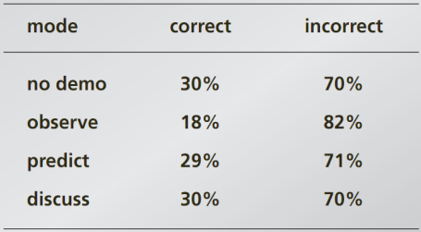
In-class Physics Demos
Which group did the worst on the post-test, missing the most points?
  Students who did not observe a demo (control group)
  Students who only observed the demo
  Students who predicted the outcome before it occurred by writing down a guess
  Students who discussed the outcome with peers after observing what occurred
E. Mazur, Keynote address at ICER 2011.
https://computinged.wordpress.com/2011/08/17/eric-mazurs-keynote-at-icer-2011-observing-demos-hurts-learning-and-confusion-is-a-sign-of-understanding/

Slide 11
Knowledge and human cognitive architecture

Slide 12
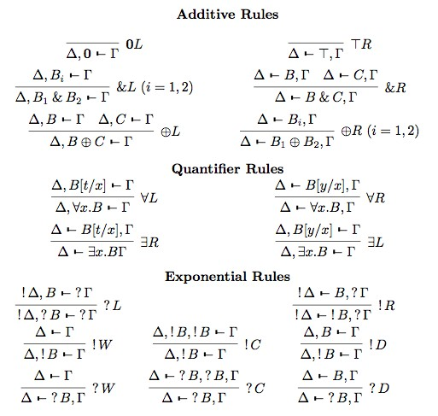
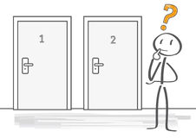



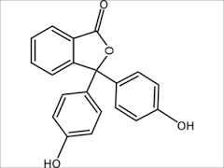
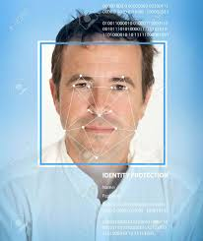

Types of Knowledge
Biologically Primary
Biologically Secondary
✕
✓
✕
✓

Slide 13
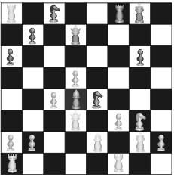
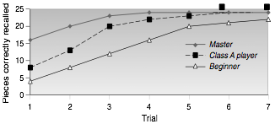
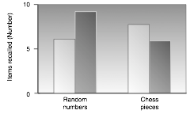

Retrieval Fluency
J.D. Bransford et al., How People Learn: Brain, Mind, Experience, and School. National Academy Press. 2000.
https://www.nap.edu/catalog/9853/how-people-learn-brain-mind-experience-and-school-expanded-edition

Slide 14

Far transfer
90 ft
90 ft
90 ft
x
90 ft
90 ft
90 ft
Apply the Pythagorean
theorem to the above
triangle to find the value
of x.
In a baseball diamond, the distance between each base is 90 ft. Which of the following is true about the shortest distance between 1st and 3rd bases (the red line shown above)?
It is less than 90 ft.
It is between 90 and 180 ft.
It is greater than 180 ft.

Slide 15
Memory Architecture

Slide 16



Human Cognitive Architecture
Central executive
Long-term memory
Working memory
Amassing
Acquiring
Auditory loop
Borrowing/ reorganizing
Visual- spatial
Information store
Randomness as genesis
WM Capacity:
4-7 items (2-3 novel)
20 seconds maximum
Interaction
Narrow limits of change
Environmental linking

Slide 17
Key findings
What works:
Deliberative effort
Interleaved and spaced practice
Try to solve problem before being taught
Testing as calibration
Pre-learning foundation
Elaborative encoding
What doesn’t:
Massed practice
Rereading texts
Learning style adaptations
Intuitive judgments
P. Brown, H. Roediger, and M. McDaniel, Make It Stick : The Science of Successful Learning.
Cambridge, MA, USA: Harvard University Press, 2014.

Slide 18
Cognitive load theory and its effects

Slide 19



Cognitive Load Theory
Goal-free effect
Germane
Load
Modality effect
Extraneous
Load
High
Intrinsic Load
Worked example effect
Imagination effect
Low
Intrinsic Load
Variability effect
A
Transient info effect
Redundancy effect
B
E
C
D

Slide 20
Worked example
Step 1: Identify the shapes
There are two right triangles with sides that are 90 ft and the red line as hypotenuse.
Step 2: Recall the formula
Pythagorean theorem:
  a² + b² = c²
Step 3: Substitute known values
  90² + 90² = c²
Step 4: Solve for c
  8100 + 8100 = c²
  16,200 = c²
  sqrt(16,200) = sqrt(c²)
  90 sqrt(2) = c
Step 5: Make a selection
Since 1 < sqrt(2) < 2, 90 < c < 180, so the correct answer is (2) between 90 and 180 ft.
90 ft
90 ft
90 ft
90 ft
In a baseball diamond, the distance between each base is 90 ft. Which of the following is true about the shortest distance between 1st and 3rd bases (the red line shown above)?
It is less than 90 ft.
It is between 90 and 180 ft.
It is greater than 180 ft.

Slide 21
Variability effect
Calculate distance between (1,1) and (4,5)
Step 1: Identify the facts
Distance is the length of a hypotenuse, for a triangle with sides as the change in x and the change in y.
Step 2: Recall the formula
Pythagorean theorem:
  a² + b² = c²
Step 3: Substitute known values
  (4-1)² + (5-1)² = c²
Step 4: Solve for c
  3² + 4² = c²
  9 + 16 = c²
  25 = c²
  5 = c
Low variability:
Find distance between (2,3) and (8,11).
Medium variability:
Find distance between (2,1) and (x,13).
High variability:
Find (x,y) that has distance of 5 from (3,4).

Slide 22
Redundancy Effect
The redundancy effect occurs when information is presented in a way that includes redundant material. One example of this is to present the same idea using both visual and executive modalities, such as reading from a PowerPoint slide that has a lot of text on it. The text itself is processed initially as visual imagery, then as auditory as we “read aloud” to ourselves internally. This induces extraneous cognitive load as our minds have to cross-reference the three forms to make sure they are the same. The effect is made worse when the instructor’s voice is also reading the words. Those words must also be cross-checked for accuracy. In the end, the information is lost before it can be transferred to LTM.

Slide 23
Notice anything?

Slide 24
Redundancy Effect
The redundancy effect occurs when information is presented in a way that includes redundant material. One example of this is to present the same idea using both visual and executive modalities, such as reading from a PowerPoint slide that has a lot of text on it. The text itself is processed initially as visual imagery, then as auditory as we “read aloud” to ourselves internally. This induces extraneous cognitive load as our minds have to cross-reference the three forms to make sure they are the same. The effect is made worse when the instructor’s voice is also reading the words. Those words must also be cross-checked for accuracy. In the end, the information is lost before it can be transferred to LTM.

Slide 25
Applications of effects
Testing effect
Goal-free effect
Worked example effect
Imagination effect
Modality effect
Variability effect
Redundancy effect
Transient info effect

Slide 26
Expertise reversal and guidance fading effects

Slide 27
Questions?

