Slide 1
Teaching, Fast and Slow:
Using Peer Instruction for Active Learning
Michael S. Kirkpatrick
Department of Computer Science
JMU CFI May Symposium 2016

Slide 2
Agenda
Introduction
Two systems model of thinking
Heuristics and biases
Why active learning?
Peer Instruction
Formative assessments and ConcepTests
Practice time

Slide 3
Introduction
Assistant Professor of Computer Science
Primary research focus is CS education
Misconceptions are central to my courses
Started at JMU in 2011
Prior experience teaching mathematics for liberal arts majors at Purdue

Slide 4
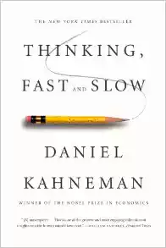
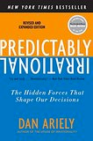
Recommended reading

Slide 5
Two systems model
LEFT
left
left
RIGHT
RIGHT
left
RIGHT
right
LEFT
left
left
RIGHT
RIGHT
left
RIGHT
right
phlegm
NOSE
sneeze
FLU
FILTHY
muddy
clean
HANDS
upper
lower
LOWER
upper
UPPER
lower
LOWER
upper

Slide 6
Two systems model
S O _ P
S O _ P
W _ S H
W _ S H
U
I
S O A P
W A S H

Slide 7
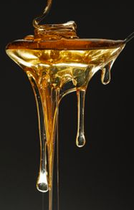
Two systems model
What you see is all there is.
System 1
Automatic and quick
Language processing
Little or no effort
No sense of voluntary control
Associative machine
Substitutes easier questions
System 2
Effortful mental activities
Calculations and critical thinking
Depends on system 1 impressions
Depletes self-control
Lazy controller
Inhibited by stress, hunger, emotion

Slide 8
Two systems model
Repeated
Experience
Feels
Familiar
Clear
Display
Feels
True
Cognitive
Ease
Primed
Idea
Feels
Good
Good
Mood
Feels
Effortless

Slide 9
Two systems model
How happy are you with your life these days?
Are you better at driving than the average driver?
How effective is your style of teaching?
What is my mood right now?
Have I caused an accident recently?
Do I observe some students doing good work?

Slide 10
Heuristics and biases
Which group can you make more words from?
XUZONLCJM vs. TAPCERHOB
Which is a more common cause of death?
Strokes or all unintentional accidents/poisonings combined
Which is more common?
Words that start with “k” or words with “k” as the third letter
Available examples shape responses

Slide 11
Heuristics and biases
Write this number down on a piece of paper:
25
Are you older or younger than this?

Slide 12
Heuristics and biases
About what percentage of African nations are in the UN?
20%
45%
73%
98%

Slide 13
Heuristics and biases
About what percentage of African nations are in the UN?
20%
45%
73%
98%
Numbers act as anchors that prime responses

Slide 14
Heuristics and biases
phlegm
NOSE
sneeze
FLU
FILTHY
muddy
clean
HANDS
W A S H
S O A P

Slide 15
Heuristics and biases
Linda is thirty-one years old, single, outspoken, and very bright. She double majored in philosophy and criminal justice. As a student, she was deeply concerned with issues of discrimination and social justice, participated in protests against the 2003 invasion of Iraq, and served as a delegate to the National Black Student Union Conference.

Slide 16
Heuristics and biases
Which of the following is most likely?
Linda is a corporate lawyer.
Linda is an investment banker for Goldman Sachs.
Linda is an elementary school teacher in a wealthy suburban district.
Linda works two jobs as a fast food dishwasher and a custodian staff manager.
Linda is a corporate lawyer who does pro bono work for the Black Lives Matter movement.

Slide 17
Heuristics and biases
Which of the following is most likely?
Linda is a corporate lawyer.
Linda is an investment banker for Goldman Sachs.
Linda is an elementary school teacher in a wealthy suburban district.
Linda works two jobs as a fast food dishwasher and a custodian staff manager.
Linda is a corporate lawyer who does pro bono work for the Black Lives Matter movement.
Representative examples suppress base rate statistics knowledge

Slide 18
Heuristics and biases
corporate
lawyers
BLM
advocates
Linda
Not
Linda

Slide 19
Heuristics and biases
Which of these words do you associate more strongly with the passage about Linda?
old vs. liberal
The halo effect creates perceptions that match our emotions

Slide 20
Heuristics and biases
System 1 consequences
Availability heuristic
Priming and anchors
Representative samples & base rate bias
Halo effect: emotionally coherent perceptions
Affect heuristic: preferences influence beliefs
Overconfidence (Dunning-Kruger) and procrastination
Risk assessment and prospect theory

Slide 21
Pedagogical implications
Think-pair-share activity
Think of an instance or a topic that your students frequently miss on exams. Which biases, heuristics, or system 1/system 2 effects might be contributing to this?
Pair with someone at your table and describe the instance you thought of.
Share with everyone at your table, looking for common themes or causes.

Slide 22
Pedagogical implications
Pedagogical implications of system 1
Computes more than intended (mental shotgun)
Subject to biases and heuristics
Focuses on existing evidence, ignores what’s absent
“What you see is all there is”
Can be trained by system 2 to detect patterns and execute skilled intuitions
Active learning and formative assessment train system 1

Slide 23
“Adopting instructional practices that engage students in the learning process is the defining feature of active learning.”
-Michael Prince
ALL

Slide 24
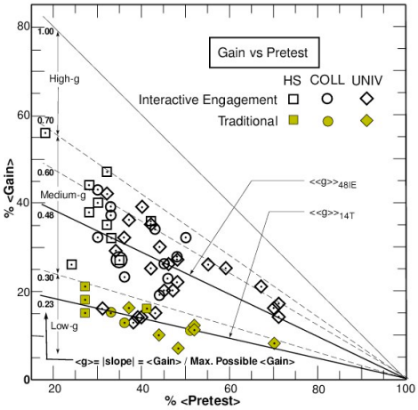
Why active learning?
Pre- vs. post- in physics
Mechanics Diagnostic
Force Concept Inventory
62 courses (14 trad.) at multiple institutions
6542 students (2084)
Worst active learning comparable to best traditional lecture
R.R. Hake, "Interactive-engagement vs traditional methods: A six-thousand-student survey of
mechanics test data for introductory physics courses," Am. J. Phys. 66, 64- 74 (1998).
http://www.physics.indiana.edu/~sdi/ajpv3i.pdf

Slide 25
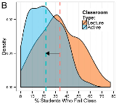
Why active learning?
Metaanalysis of 225 studies
158 studies: average 0.47 SDs better on CIs/exams
67 studies: average failure rate dropped from 33.8% to 21.8%
S. Freeman et al., “Active learning increases student performance in science, engineering, and mathematics,” Proceedings of the National Academy of Sciences 111(23), 8410- 8415, 2014.
http://www.ncbi.nlm.nih.gov/pmc/articles/PMC4060654/pdf/pnas.201319030.pdf

Slide 26
Why active learning?

Slide 27
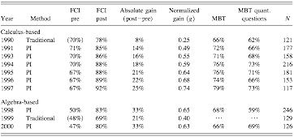
Peer Instruction
These were NOT “worse” students
(post - pre)
1 - pre
These were NOT “worse” students

Slide 28
Peer Instruction
Can be Canvas/JiTT
Class structure
Daily or weekly reading quizzes to address basic definitions
Minimum of 15 minutes per concept
7-10 minutes of lecture
5 - 8 minutes for ConcepTest
Vote first, discuss, vote again, debrief
Exams aligned with concepts
Not multiple choice, emphasize core ideas
3-2-1-0 grading scheme
Graded but low-stakes

Slide 29
Peer Instruction
Reading Quiz Question
Without air resistance, an object dropped from a plane flying at constant speed in a straight line will
quickly lag behind the plane
remain vertically under the plane
move ahead of the plane
not covered in the reading assignment
Exam Question
Two stones are released from rest at a certain height, one after the other. (a) Will the difference in their speeds increase, decrease, or stay the same? (b) Will their separation distance increase, decrease, or stay the same? (c) Will the time interval between the instants at which they hit the ground be smaller than, equal to, or larger than the time interval between the instants of their release?

Slide 30
Peer Instruction
ConcepTest
A person standing at the edge of a cliff throws one ball straight up and another ball straight down at the same initial speed. Neglecting air resistance, the ball to hit the ground below the cliff with the greater speed is the one initially thrown
upward.
downward.
neither—they both hit at the same speed.
Answer: 3. Upon its descent, the velocity of an object thrown straight up with an initial velocity v is exactly -v when it passes the point at which it was first released.

Slide 31
Peer Instruction
ConcepTest
Consider the following statement:
Bill should quit smoking because people who smoke get lung cancer.
What is the best interpretation of the premise?
Most people who smoke get lung cancer.
Everyone who smokes gets lung cancer.
Some people who some sometimes get lung cancer.
People who smoke are more likely to get lung cancer than people who don’t smoke.
Answer: 4. This example illustrates the principle of charity by introducing the claim of likelihood into the speaker’s assertion.
Peer Instruction in the Humanities Project, Monash University
http://artsonline.monash.edu.au/peer-instruction-in-the-humanities

Slide 32
Peer Instruction
Examples of Peer Instruction in the humanities
Have students select the main idea in a text, audio, or video clip.
Engage students in discussion about a key point in an image, text, audio, or video clip that may have more than one valid answer.
Solicit views on contentious points and explain their perspectives to peers.
Peer Instruction Blog
https://blog.peerinstruction.net/2013/06/10/3-easy-ways-to-use-clickers-and-peer-instruction-in-the-arts-and-humanities/

Slide 33
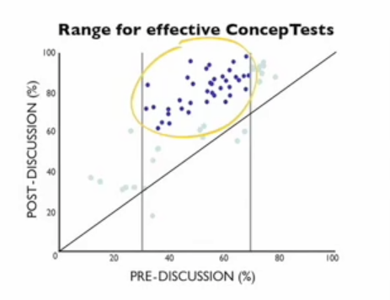
ConcepTests
Guidelines for writing ConcepTests
Focus on a single concept
Require conceptual understanding, not solvable with just equations or facts
Use unambiguous language
Use students’ wrong answers from old exams as options
Avoid converging answers
Un-situate concepts with near and far transfer
Be aware of intrinsic, germaine, and extraneous cognitive load
Provide worked examples, not just solutions

Slide 34
Far transfer
90 ft
90 ft
90 ft
x
90 ft
90 ft
90 ft
Apply the Pythagorean
theorem to the above
triangle to find the value
of x.
In a baseball diamond, the distance between each base is 90 ft. Which of the following is true about the shortest distance between 1st and 3rd bases (the red line shown above)?
It is less than 90 ft.
It is between 90 and 180 ft.
It is greater than 180 ft.

Slide 35
Work time
ConcepTest writing
Recall the learning objective that you identified as challenging for students in the think-pair-share
Construct a stem for that objective
Write a misconception or two that students have about the topic
Rephrase the misconception as an answer
Test your ConcepTest on a peer from a different discipline

Slide 36
Backup slides

Slide 37
ConcepTests
The Force Concept Inventory (FCI) is a validated test to measure learning in physics. Students take the FCI on the first and last day of class. In one study, women scored an average of 60% on the pretest; women in traditional lectures scored an average of 70% on the posttest, whereas women in interactive classrooms scored an average of 85% on the posttest. Men scored an average of 70% on the pretest; men in traditional lectures scored an average of 80% on the posttest, compared with 87% in interactive classrooms.

Slide 38
ConcepTests
Which statement best summarizes the pre- vs. post- test gender performance gap in the physics courses studied?
In both traditional and interactive classrooms, the gender performance gap increased on the post-test.
The gender performance gap increased in traditional lectures but stayed constant in interactive classrooms.
The gender performance gap stayed constant in traditional lectures but decreased in interactive classrooms.
The gender performance gap increased in traditional lectures but decreased in interactive classrooms.

Slide 39
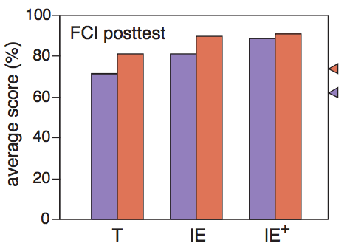
ConcepTests
Cooperative learning closes the gender gap
Pre-test scores were 10% points higher for men
Gap persisted with lecture alone
Post-test results for cooperative classes were almost equal
Requires more than just interactive lecture
T: traditional lectures
IE: interactive lectures
IE+: interactive assignments, lectures, tutorials
E. Mazur, “The scientific approach to teaching: Research as a basis for course design,” keynote/plenary
talk at the International Computing Education Research Conference (ICER), 2011.
http://mazur.harvard.edu/search-talks.php?function=display&rowid=1712

Slide 40
ConcepTests
The evidence supporting active learning suggests that passive engagement with information can contribute to reinforcing misconceptions. One study examined how effective in-class physics demonstrations were in helping to understand concepts. All students began with a reading assignment. Some students then took part in an in-class demonstration; the control group did not observe or take part in a demonstration. The students completed a short test to conclude the experiment. Which group did the worst on the post-test, missing the most points?

Slide 41
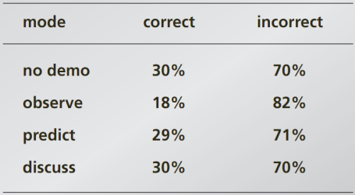
ConcepTests
Which group did the worst on the post-test, missing the most points?
Students who did not observe a demo (control group)
Students who only observed the demo
Students who predicted the outcome before it occurred by writing down a guess
Students who discussed the outcome with peers after observing what occurred

Slide 42
Two systems model
Christopher Chabris and Daniel Simons
The Invisible Gorilla
http://www.theinvisiblegorilla.com/videos.html

