Slide 1
Where We’ve Been and Where We Are
Implications for Diversity in Computing
Michael S. Kirkpatrick
JMU Computer Science
CAPWIC 2017

Slide 2
You belong in
Computer Science and
it’s a great place to be

Slide 3
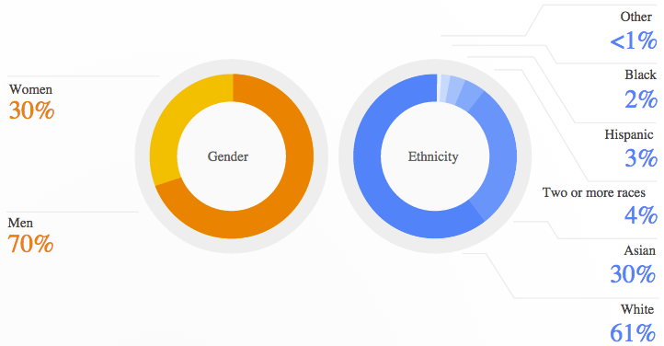
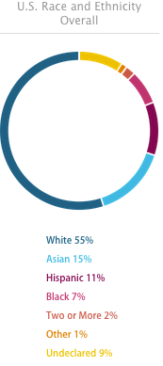
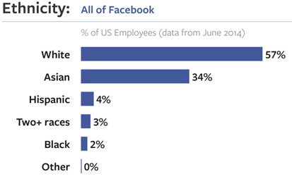
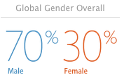

Slide 4
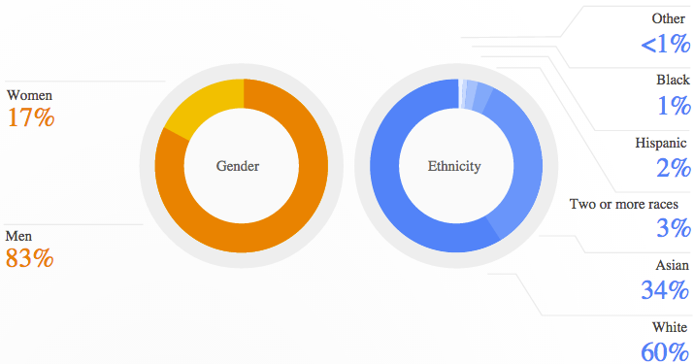
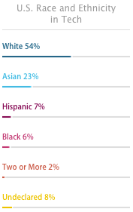
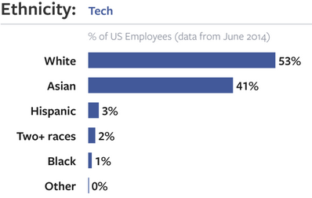
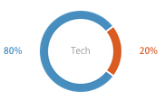

Slide 6
A culture problem?
“It's difficult to even get a modicum of respect. They talk down to you. They belittle you.”
“It is not misogyny to tell a sexist joke, or to fail to take a woman seriously…”
Strip show at Black Hat
RSA Conference “booth babes”
Julie Ann Horvath’s departure
Brogrammer culture
Sarah Sharp vs. Linus Torvalds
Ellen Pao vs. Kleiner Perkins
Tropes vs. Women
Whitney Wolfe as Tinder co-founder
#gamergate
“I’m honestly trying to understand why anyone says that females are ‘needed’ in the tech industry. The tech community works fine without females, just like any other mostly male industry. Feminists probably just want women making more money.”
“This is an industry filled with sociopaths who cannot see another individual as a human being.”
Having a woman on the board “makes the company seem like a joke.”

Slide 7
The leaky pipeline:
“The pipeline is leaky and full of acid. The pipeline leads to a sewage treatment plant. The pipeline ends in a meat grinder.”
-Julie Pagano*
A culture problem?
*Diversity for Sale (http://juliepagano.com/blog/2015/02/07/diversity-for-sale/)

Slide 8
Computer Science is...
the systematic study of the feasibility, structure, expression, and mechanization
of the methodical procedures (or algorithms) that underlie the acquisition, representation, processing, storage, communication of, and access to information
Computer Science is...
the systematic study of
information

Slide 10
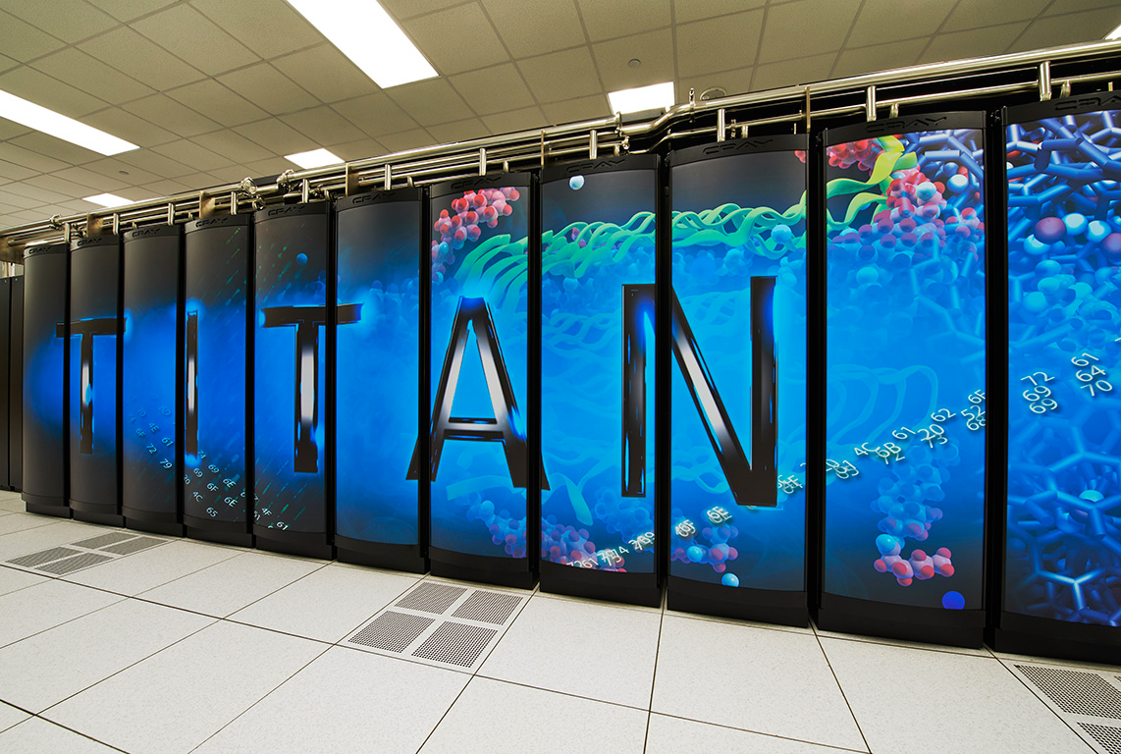
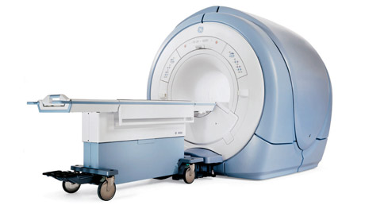
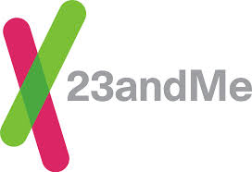
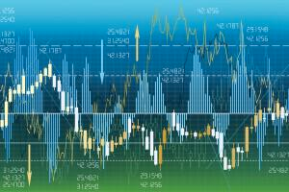
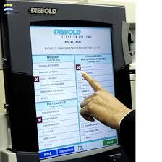

Slide 11
Top 10 Best Jobs in America 2017*
Mobile Applications Developer
Risk Management Director
Landman
Product Analyst
Information Assurance Analyst
Quality Assurance Coordinator (RN)
Clinical Applications Specialist
Hospital Administrator
Database Analyst
Finance & Administration Director
*CNN Money (http://money.cnn.com/pf/best-jobs/2017/list/)

Slide 12
Computer Science is...
collaborative
beneficial to society
fun and interesting
…and it should reflect society

Slide 13
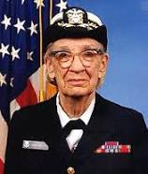
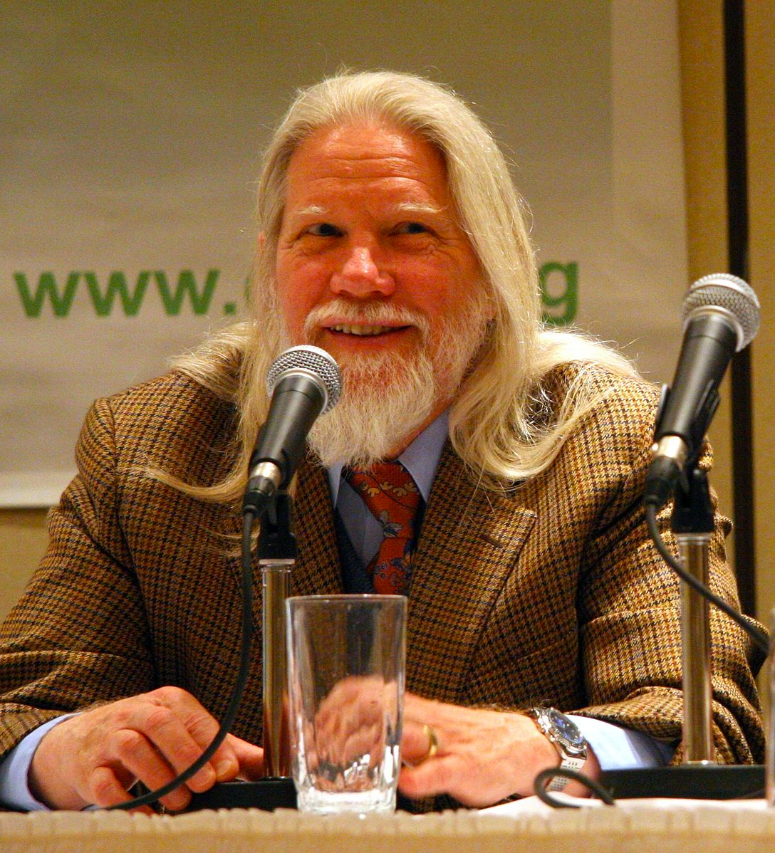
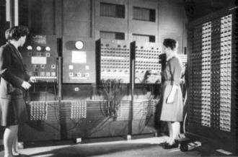
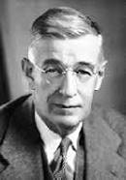
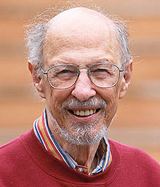
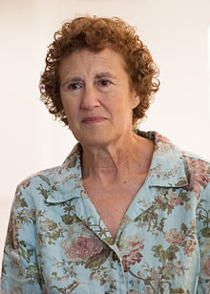
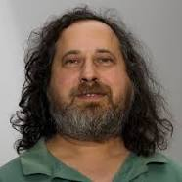
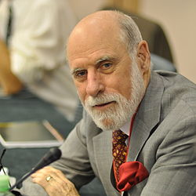
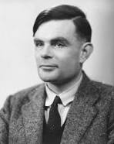
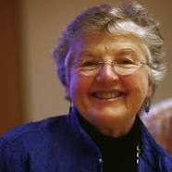
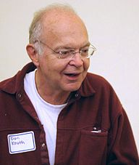
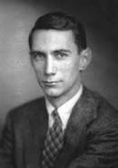
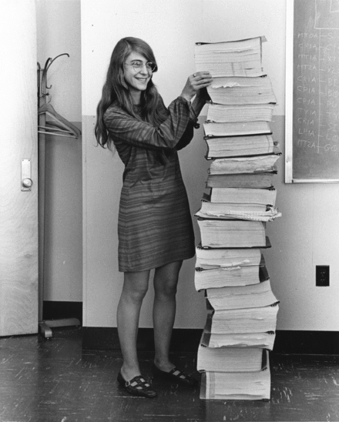
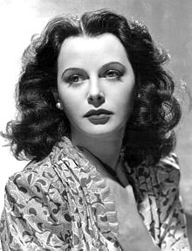
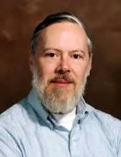
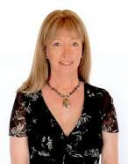
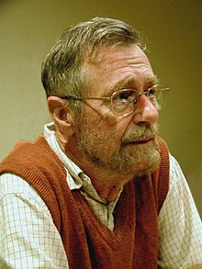
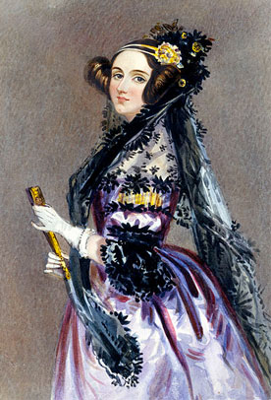
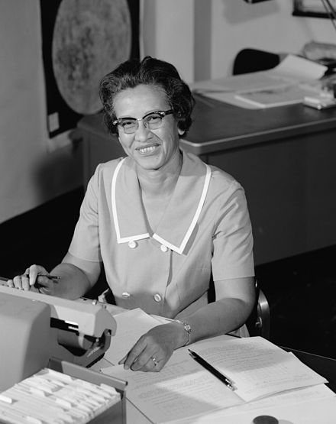

Slide 14
Barbara Liskov’s work is critical for OOP
Grace Hopper…
Frances Allen made optimizing compilers possible
Radia Perlman invented key parts of the Internet
Margaret Hamilton’s code saved the first moon landing
Hedi Lamarr’s invention made Bluetooth possible
Ada Lovelace wrote the world’s first computer program

Slide 15
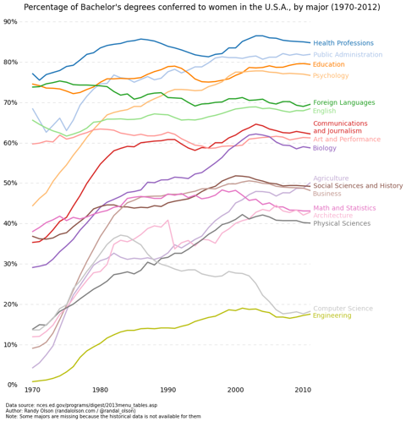
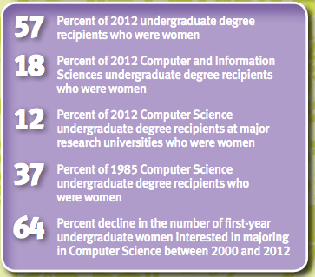
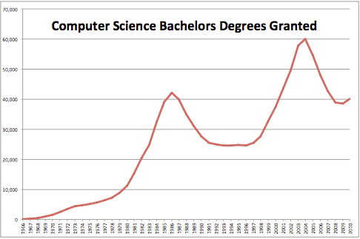
http://ncwit.org/

Slide 16
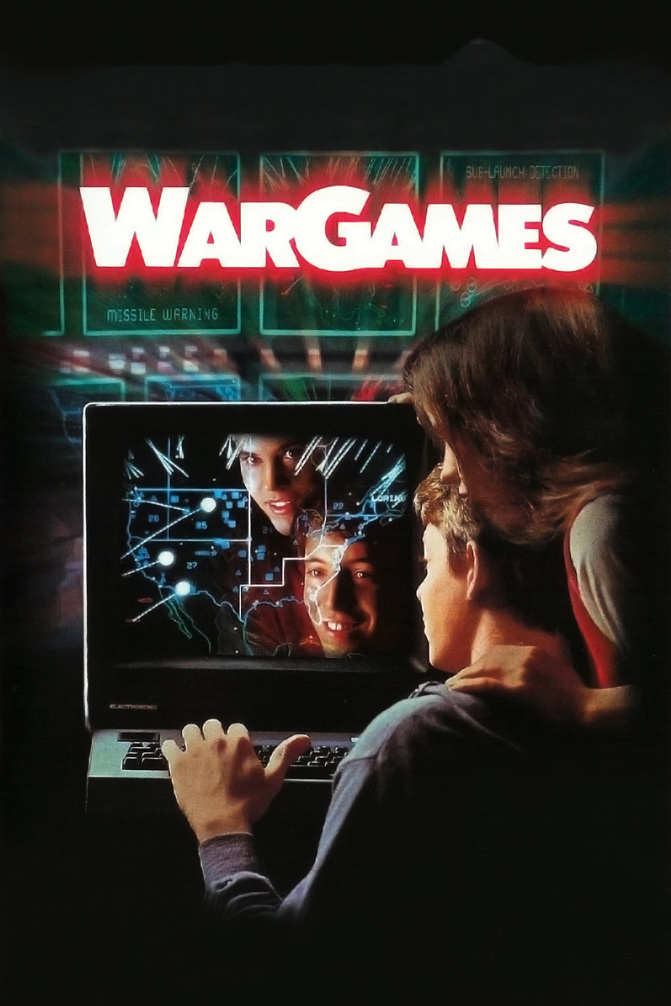
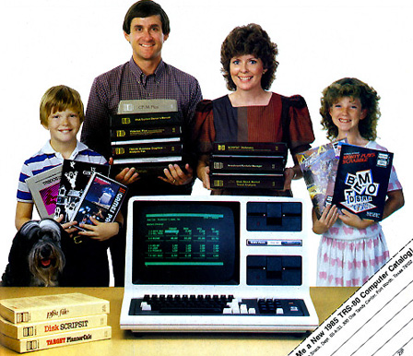
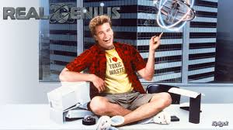
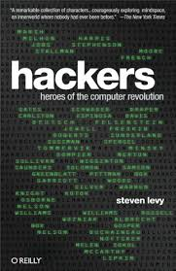
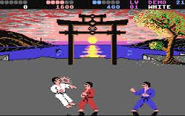
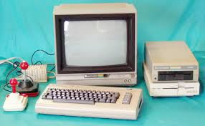
1980s: The “Golden Age”
Level playing field?

Slide 17
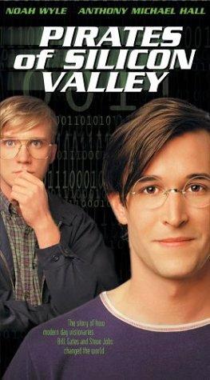
2000s: Dot-com boom and bust

Slide 18
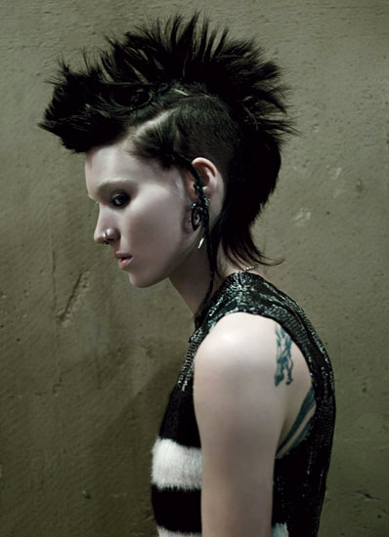
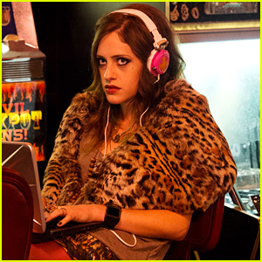
The Third Surge
“One category of reactions that I receive all the time as a programmer that presents as feminine is: No one believes I am a programmer. I can’t tell you how many people, when meeting me and hearing my profession, tell me that I look like a designer, someone in accounting, someone in marketing, anything but a programmer.”

Slide 19
Girls’ choices are constrained
Steered away by parents, teachers, others
“Computing is for boys”
Underrepresentation is a vicious cycle
Lack of role models
Girls systematically underestimate their abilities
Accurate feedback is critical
Girls anticipate work-family conflicts
Discrimination limits opportunities
Punished for exhibiting competence
Cheryan, S., Master, S., and Metzloff, A.N. “Cultural stereotypes as gatekeepers: increasing girls’ interest in computer science and engineering by diversifying stereotypes.” Frontiers in Psychology, 11 February 2015,
http://journal.frontiersin.org/article/10.3389/fpsyg.2015.00049/full.

Slide 22
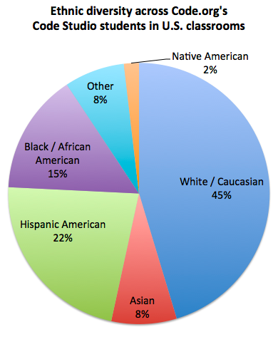
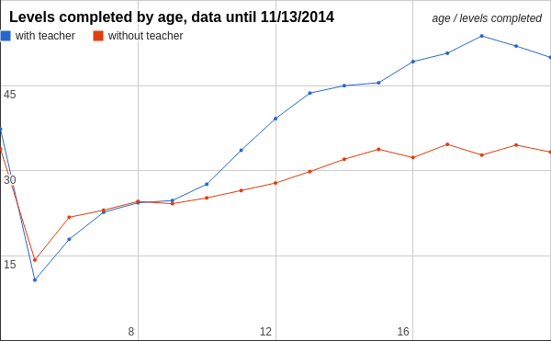
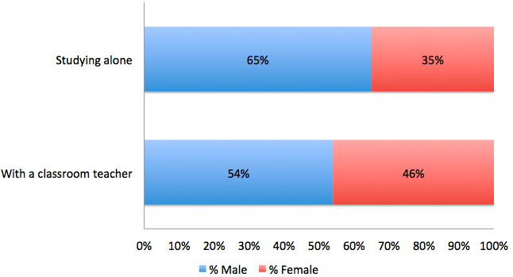

Slide 23
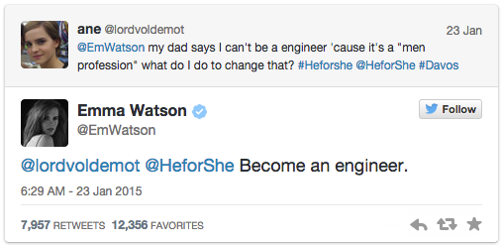

Slide 24
Thank you!

Slide 25
Where to go for more information
National Council for Women & Information Technology (http://www.ncwit.org/)
ACM’s Women in Computing (ACM-W) (http://women.acm.org/)
CS10K Project (http://cs10kcommunity.org/)
Code.org (http://code.org/)
Anita Borg Institute (http://anitaborg.org/)
Girls Who Code (http://girlswhocode.com/)
Black Girls Code (http://blackgirlscode.com/)
Model View Culture (https://modelviewculture.com/)
Learn to write Python code:
http://www.codecademy.com/en/tracks/python
http://learnpython.org/

Slide 26
Where to go for more information
Alice (http://alice.org/)
AppInventor (http://appinventor.mit.edu/)
Computer Science Unplugged (http://csunplugged.org/)
Finch Robots (http://finchrobot.com/)
Lightbot (http://lightbot.com/)
Scratch (http://scratch.mit.edu/)
Snap! (Build Your Own Blocks) (http://snap.berkeley.edu/)
Girl Develop It (https://www.girldevelopit.com/)
TEALS (https://www.tealsk12.org/)
Bootstrap (http://www.bootstrapworld.org/)
Code 2040 (http://www.code2040.org/)
ScriptEd (https://scripted.org/)

Slide 27
Recommendations

